Slide 1


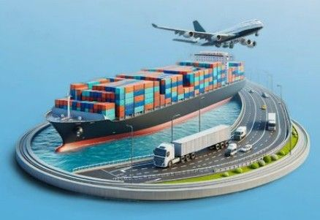
Resilient and Sustainable Supply Chains in Africa: Lessons from Global Pandemics and Pathways for Post-COVID Transformation
Dr. Eke Endurance Ikechi, PhD, PMP, FCILT
Lecturer, Department of Logistics & Supply Chain Management, Admiralty University of Nigeria

Slide 2
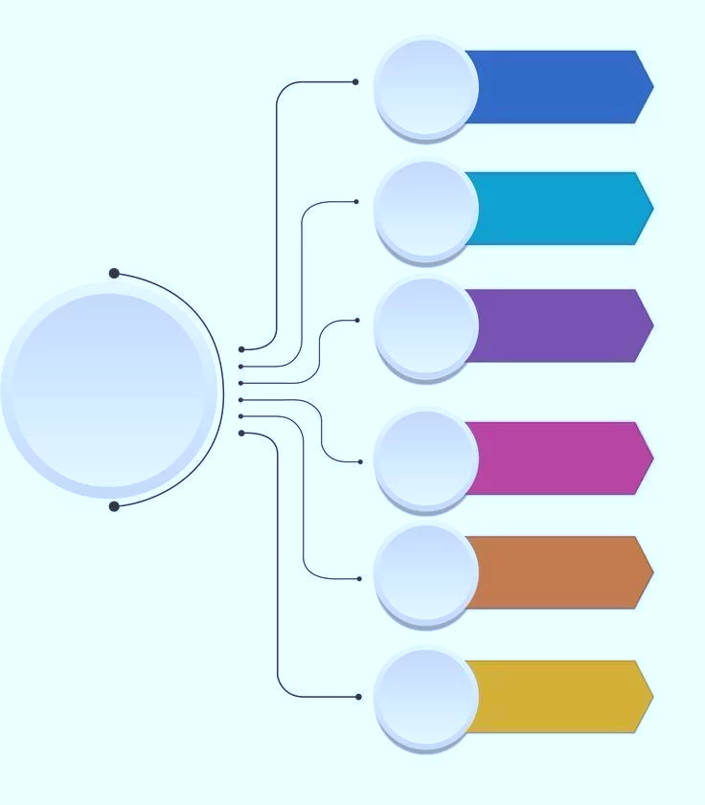

Introduction
Ten Major Pandemics and Global Supply Chain Disruptions
Nigeria/Africa Perspective
Pandemic Impact on Supply Chains
Concept of Resilience and Sustainability
Key Operational Strategies
Digitalization & Decision Models
Conceptual Framework
Policy Implications
Conclusion
Table of contents

Slide 3

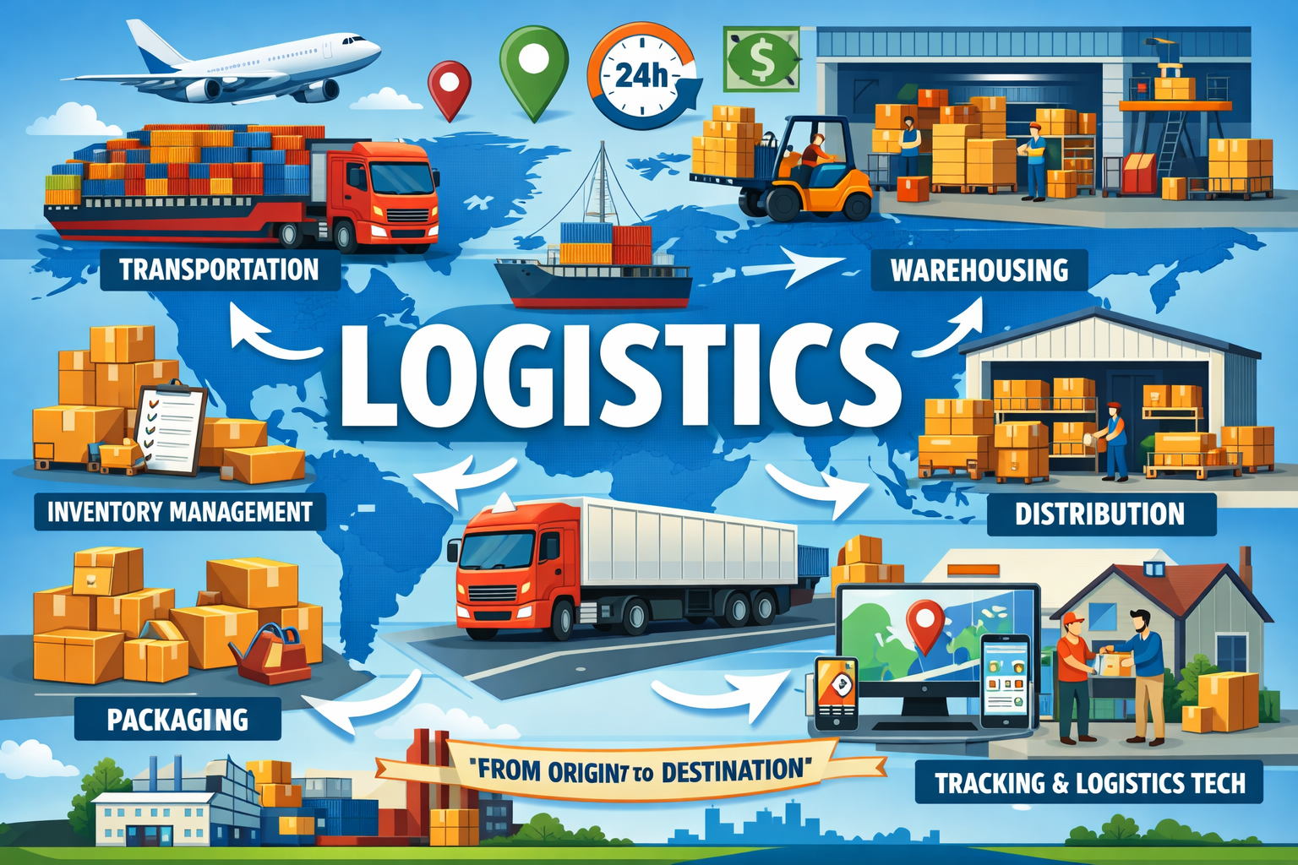
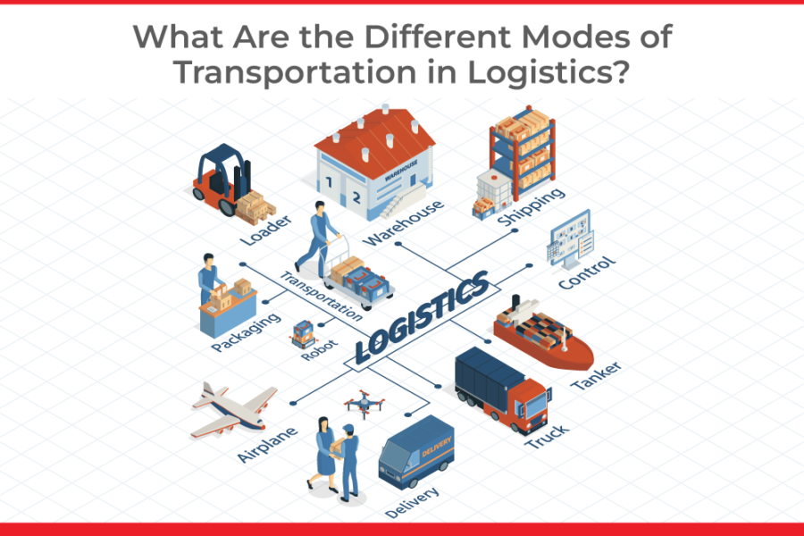
Introduction
Global supply chains have shifted due to major disruptions like pandemics.
Traditional systems focused on efficiency and cost are now seen as fragile.
COVID-19 exposed weaknesses such as single sourcing, poor visibility, and weak risk planning.
Modern supply chains must become resilient, adaptable, and sustainable to handle future disruptions.

Slide 4

• Pandemics have always disrupted global trade, economies, and supply chains.
• They affect labor, production, transportation, and international trade flows.
• The Antonine Plague weakened Roman trade and forced local production.
• The Black Death collapsed major trade routes and led to quarantine systems.
• Smallpox disrupted global trade but led to widespread vaccination programs.
• Cholera affected maritime trade and improved sanitation and water systems.
• Russian Flu disrupted early industrial supply chains and introduced health monitoring.
• Spanish Flu caused massive global supply chain breakdowns and led to public health systems.
• HIV/AIDS and SARS disrupted workforce and logistics, leading to medical and risk management systems.
• COVID-19 caused global supply chain shocks and accelerated digitalization, diversification, and resilience strategies.

Slide 5
Nigeria and Africa face supply chain challenges like poor infrastructure, road dependence, port congestion, and low digital adoption.
These challenges increase vulnerability to disruptions and reduce logistics efficiency.
Opportunities exist through investments in multimodal transport, digital systems, regional integration (AfCFTA), and stronger local supply chains.
Nigeria/Africa Perspective

Slide 6
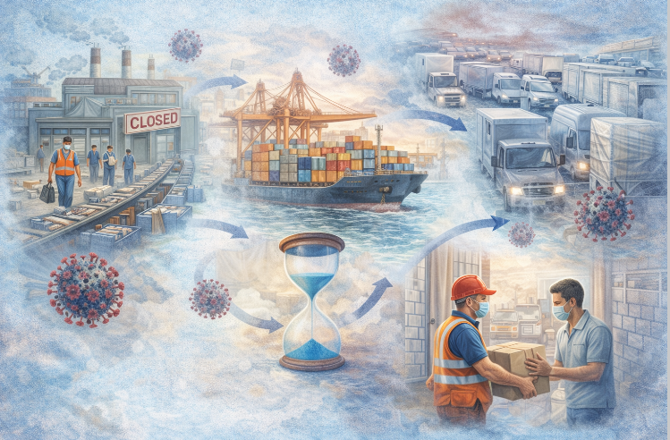
Pandemic Impact on Supply Chains
Pandemics disrupt supply chains by affecting production, labor, transportation, and demand at the same time.
They cause major problems like factory shutdowns, border closures, port congestion, and delivery delays.
These disruptions show the need for flexible, resilient supply chains with better risk management and backup plans.

Slide 7
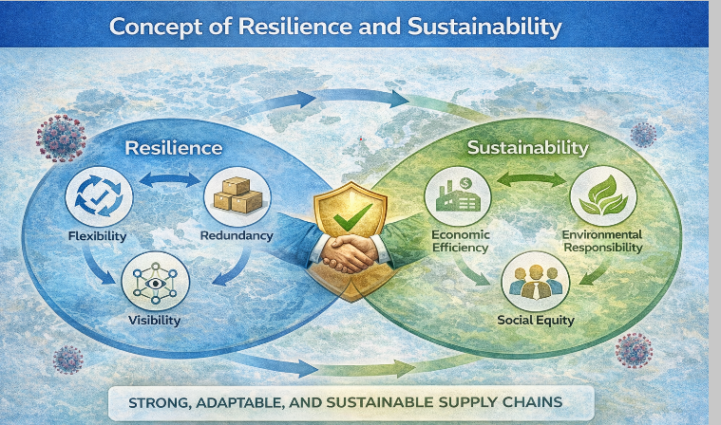
Concept of Resilience and Sustainability
Supply chain resilience is the ability to prepare for, respond to, and recover from disruptions.
It depends on flexibility, redundancy, visibility, and collaboration.
Sustainability focuses on balancing economic, environmental, and social goals.
Combining resilience and sustainability creates stronger, more adaptable, and long-lasting supply chains.

Slide 8
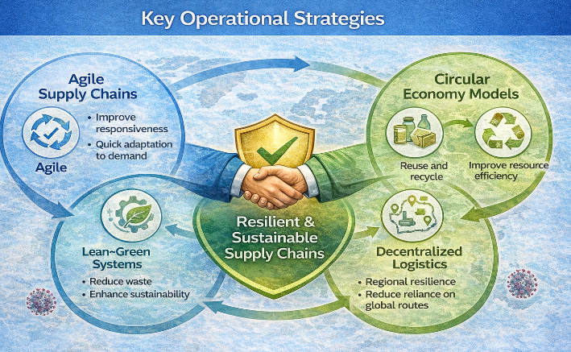
Key Operational Strategies
Organizations are adopting strategies like agile, lean–green, circular, and decentralized supply chains.
Agile systems improve flexibility and quick response to changing demand.
Lean–green and circular models reduce waste, promote recycling, and support sustainability.
Decentralized networks reduce reliance on global routes and improve resilience to disruptions.

Slide 9
Global Logistics Case Comparison
Company | Resilience Strategy | Sustainability Strategy | Key Outcome
DHL | Digital control tower, rerouting | Electric fleet, SAF | Improved visibility & reduced emissions
Maersk | Route diversification | Green methanol ships | Reduced congestion impact
Amazon | Decentralized fulfillment | Electric vans, renewables | Faster delivery & lower carbon footprint

Slide 10
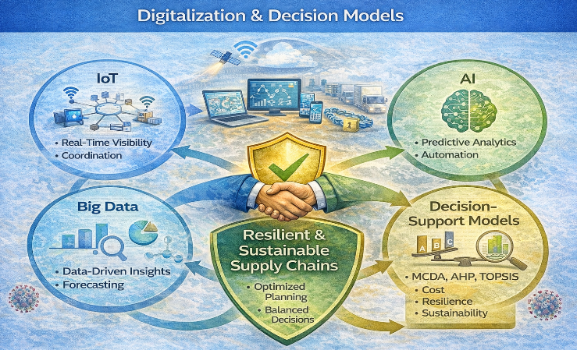
Digitalization & Decision Models
Digital technologies like IoT, AI, big data, and blockchain improve supply chain performance.
They provide real-time visibility, better coordination, and faster decision-making.
Decision models like MCDA (AHP, TOPSIS) help compare cost, resilience, and sustainability.
These tools support better planning and optimized supply chain design in uncertain conditions.

Slide 11
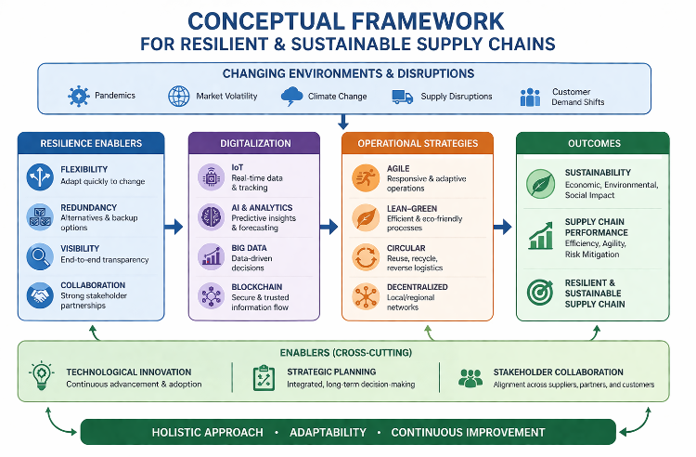

Slide 12

Policy Implications
• Strong government policies are needed to build resilient and sustainable supply chains, especially in developing countries.
• Investment in infrastructure, digital technology, and skills development is essential for supply chain improvement.
• Public–private collaboration and sustainability policies (e.g., green logistics, carbon reduction) support long-term resilience and growth.

Slide 13

Conclusion
The increasing frequency of global disruptions shows that supply chains must move beyond efficiency and integrate resilience and sustainability into their core design.
By leveraging digital technologies and innovative strategies, organizations can build adaptive, sustainable, and intelligent supply chains that deliver long-term economic and environmental value.

Slide 14



Slide 15



Thank you

