Slide 1





KEYNOTE PRESENTATION
Logistics: The Engine Room of Nigeria's Economy
An interrogation of the macroeconomic engine that moves Nigeria — its scale, its strain, its innovations, and the legislative roadmap.
Boboye Oyeyemi, Ph.D
OFR, mni, NPOM, FCILT, NPOM, FCIPM, FNIM
RTD Corps Marshall FRSC
President and Chairman of Council
CILT Nigeria
City Business News Anniversary Lecture • 2026

Slide 2


ROADMAP FOR TONIGHT
Four Modules. One Engine Room.
01
02
03
04
The Anatomy of the Engine Room
Squeezing the Pistons
Innovations Refueling the System
The Roadmap to 2027
Sizing the macro picture — GDP footprint, food security, and the formal/informal schism.
The operational cost pressures — diesel shocks, fiscal friction, and infrastructure deficits.
CNG transition, digital freight-matching, and the maritime barge boom.
The legislative case for the enforcement of professionalism in Nigeria Logistics eco-system.
Closing: An Honest Conclusion & Three Actionable Recommendations
AGENDA
CITY BUSINESS NEWS ANNIVERSARY LECTURE
1

Slide 3
TODAY'S PROVOCATION
Four Numbers That Define This Conversation
Before we diagnose the engine room, sit with the scale of what's at stake — and the scale of what's leaking.
$11.66b
Nigeria's freight & logistics market asset class.
Source: Mordor Intelligence
N1 trillion+
Annual contribution to national GDP.
Source: NBS
43.67%
Year-on-year surge in diesel prices.
Source: NBS
$3 billion
Lost yearly to food spoilage in transit. Source:
Rome Business School NIgeria
The thesis of today's lecture: logistics is not a peripheral service industry — it is the vascular system of the Nigerian economy. And right now, that system is running hot.
OPENING
CITY BUSINESS NEWS ANNIVERSARY LECTURE
2

Slide 4
MODULE 01 / 04
The Anatomy of the Engine Room
Interrogating the macro picture — using empirical GDP data to show how logistics holds the balance of Nigeria's economic stability.
THE ANATOMY OF THE ENGINE ROOM
3

Slide 5

MODULE 1 · THE MACRO FRAME
The Scale: An $11.66 Billion Asset Class
Nigeria's freight and logistics market has officially crossed the threshold into a multi-billion-dollar market asset class.
This scale places logistics firmly among the structurally significant sectors of the national economy — alongside oil, agriculture, and telecoms.
The market spans haulage, freight forwarding, warehousing, last-mile delivery, and the digital platforms now layered on top of all three.
$11.66b
Nigerian freight & logistics market size
MODULE 1 · ANATOMY OF THE ENGINE ROOM
CITY BUSINESS NEWS ANNIVERSARY LECTURE
4

Slide 6

MODULE 1 · THE MACRO FRAME
The GDP Footprint Crosses N1 Trillion
3.73%
Share of Nigeria's GDP contributed by the logistics value chain
N1 trillion+
Logistics value chain output — a milestone crossed this cycle
“Logistics is not an isolated service industry. At over N1 trillion in economic output, it functions as the literal vascular system that permits the manufacturing, agricultural, and retail sectors to breathe.”
MODULE 1 · ANATOMY OF THE ENGINE ROOM
CITY BUSINESS NEWS ANNIVERSARY LECTURE
5

Slide 7
MODULE 1 · THE MACRO FRAME
Growth Trajectory: A Resilient Non-Oil Pillar
Despite severe macroeconomic shocks — currency fluctuations and energy pricing reforms — the broader services sector continues to anchor non-oil growth.
Transportation and Storage, led by Road Transport, is explicitly cited by the NBS as a resilient pillar holding the non-oil economy steady.
This resilience is happening despite the cost pressures we interrogate in Module 2 — a sign of the sector's structural importance, not its comfort.
3.89%
Nigeria's real GDP growth, year-on-year (NBS, Q1 2026)
MODULE 1 · ANATOMY OF THE ENGINE ROOM
CITY BUSINESS NEWS ANNIVERSARY LECTURE
6

Slide 8

KEYNOTE TAKEAWAY
A breakdown in supply chain velocity does not stay in the warehouse — it paralyzes retail trade and triggers urban scarcity within weeks.
MODULE 1 · ANATOMY OF THE ENGINE ROOM
7

Slide 9

MODULE 1 · FOOD SECURITY & RETAIL NEXUS
When the Cold Chain Fails, Inflation Follows
Agriculture represents roughly 25% of Nigeria's GDP and employs more than 35% of the national workforce — making it the country's largest source of livelihoods.
Yet the corridor between the nation's food basket and its retail shelves is structurally fragile: inefficient supply chains and severe cold-chain deficits define the journey.
The systemic risk becomes obvious the moment you trace a single tomato truck from the Middle Belt to a market in Lagos.
25%
of GDP from Agriculture
MODULE 1 · ANATOMY OF THE ENGINE ROOM
CITY BUSINESS NEWS ANNIVERSARY LECTURE
8

Slide 10
MODULE 1 · FOOD SECURITY & RETAIL NEXUS
The Agriculture Value Freeze
25%
Share of Nigeria's GDP from agriculture
35%+
Share of the national workforce employed in agriculture
30–40m
Metric tonnes of food lost annually to post-harvest wastage
Source: Rome Business School Nigeria & the Organisation for Technology Advancement of Cold Chain in West Africa.
The data reveals a stark reality: inefficient supply chains and severe cold-chain deficits are freezing the value of one of Nigeria's largest economic contributors.
Every tonne lost in transit is a tonne that never reaches a retail shelf, a farmer, or a household budget — it simply evaporates from the economy.
MODULE 1 · ANATOMY OF THE ENGINE ROOM
CITY BUSINESS NEWS ANNIVERSARY LECTURE
9

Slide 11
MODULE 1 · FOOD SECURITY & RETAIL NEXUS
The Billions Lost in Transit
$2.3–$3.3b
Estimated annual financial drain from post-harvest logistics failure
N3.5–5 trillion
Naira-equivalent value lost every single year
Up to 40%
Of farm produce eroded before reaching a retail shelf
When moving perishable goods from the Middle Belt down to high-demand hubs like Lagos and Abuja, long transport times, poor rural roads, and predatory checkpoint pricing erode value at every stage of the journey.
MODULE 1 · ANATOMY OF THE ENGINE ROOM
CITY BUSINESS NEWS ANNIVERSARY LECTURE
10

Slide 12




MODULE 1 · FOOD SECURITY & RETAIL NEXUS
Anatomy of a Broken Supply Corridor
Middle Belt Harvest
Inadequate Cold Chain
& Poor Roads
Up to 40%
Post-Harvest Loss
Elevated Food Inflation
in Lagos / Abuja
The nation's food basket produces at scale.
Long transit times, predatory checkpoints.
Produce spoils before reaching market.
Urban consumers absorb the shortfall.
Interrogating this reveals that food inflation in Nigeria is fundamentally a logistics crisis — not just a production crisis.
MODULE 1 · ANATOMY OF THE ENGINE ROOM
CITY BUSINESS NEWS ANNIVERSARY LECTURE
11

Slide 13
MODULE 1 · THE DUAL REALITY
The Formal vs. Informal Schism
Formal logistics (N535.5b) runs on structured corporate fleets, digital freight-matching platforms, and institutionalized 3PL/4PL hubs — capital-heavy but vulnerable to regulatory bottlenecks.
Informal transport (N468.4b) is fragmented and cash-driven, yet immensely resilient across sub-optimal routes — it is what keeps the last mile moving.
The reliance on informal operators restricts tracking and visibility, exposes cargo to inconsistent multi-layered “taxation,” and blocks access to formal asset financing.
source: NBS
MODULE 1 · ANATOMY OF THE ENGINE ROOM
CITY BUSINESS NEWS ANNIVERSARY LECTURE
12

Slide 14
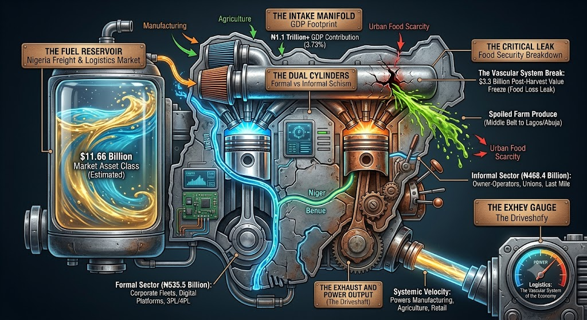

Slide 15
THE KEYNOTE HOOK — MODULE 1
The figures tell us two things. First, our logistics sector is a massive N1 trillion engine. But second, it is an engine where nearly half the cylinders — our N468 billion informal sector — operate outside structured frameworks, and where a massive $3 billion worth of fuel, in the form of spoiled food, leaks out of the system every year due to bad roads and zero cold storage. There is no need to expand this engine room; the engine room need fixing of the leaks.
Keynote Address — City Business News Anniversary Lecture
MODULE 1 · ANATOMY OF THE ENGINE ROOM
13

Slide 16
MODULE 02 / 04
Squeezing the Pistons
Moving from macroeconomic theory to the bruising operational realities of running supply chains in Nigeria.
SQUEEZING THE PISTONS
14

Slide 17
MODULE 2 · FUEL SHOCKS
The Diesel Overlord
43.67%
Year-on-year increase
NBS Diesel Price Watch, average retail price
Haulage and heavy-duty logistics in Nigeria are overwhelmingly diesel-powered — this single input sets the baseline price for nearly every consumer good.
In landlocked states like Nasarawa, prices spike well beyond the national average.
MODULE 2 · SQUEEZING THE PISTONS
CITY BUSINESS NEWS ANNIVERSARY LECTURE
15

Slide 18
MODULE 2 · FUEL SHOCKS
The Squeeze on Trip Economics
60–65%
Of a 30-tonne haulage trip's total budget now consumed by fuel alone
9.64%
down from 18.46%
Real growth in road transport, Q1 2026 vs. prior year
For a standard truck moving goods from the ports in Lagos to warehouses in Kano or Abuja, the engine is literally burning through its own cash just to keep the wheels turning.
MODULE 2 · SQUEEZING THE PISTONS
CITY BUSINESS NEWS ANNIVERSARY LECTURE
16

Slide 19

MODULE 2 · FISCAL FRICTION
Multiple Taxation & Corridor Extortion
A single truck crossing state boundaries faces an array of formal and informal levies — from state internal revenue services, local government task forces, and informal union enforcers (Agberos).
While the Joint Tax Board (JTB) and the Presidential Fiscal Policy and Tax Reforms Committee have pushed for harmonization, enforcement at the local government level remains weak.
This fragmentation acts as an internal trade barrier — slowing asset turnaround times and raising consumer prices at every state line.
MODULE 2 · SQUEEZING THE PISTONS
CITY BUSINESS NEWS ANNIVERSARY LECTURE
17

Slide 20

MODULE 2 · FISCAL FRICTION
The Financial Drain Per Trip
Industry audits trace this drain directly to the layered checkpoint system that operators must navigate state by state.
Regulatory efforts exist on paper — the JTB and the Presidential Fiscal Policy and Tax Reforms Committee have both pushed for harmonized levies.
But weak local enforcement means the corridor toll persists as a daily operating cost, baked into every consumer price.
N150,000–N250,000
Unbudgeted operational friction added per long-haul trip via informal taxes and checkpoint extortion
MODULE 2 · SQUEEZING THE PISTONS
CITY BUSINESS NEWS ANNIVERSARY LECTURE
18

Slide 21

MODULE 2 · INFRASTRUCTURE DEFICITS
The Burden of Road Dominance
The structural vulnerability of Nigeria's logistics ecosystem stems from this massive over-reliance on a single transport mode.
Every shock to road conditions — fuel prices, potholes, checkpoints — transmits directly and immediately into the cost of goods nationwide.
Alternative channels (rail, pipeline, water) exist, but as the next slide shows, they are failing to pick up meaningful slack.
90%+
Of all freight in Nigeria moves by road
MODULE 2 · SQUEEZING THE PISTONS
CITY BUSINESS NEWS ANNIVERSARY LECTURE
19

Slide 22
MODULE 2 · INFRASTRUCTURE DEFICITS
The Rail Slump: Alternatives Failing to Pick Up Slack
Rail and pipeline activity grew just 6.03% in real terms — a collapse from 68.73% growth previously.
This highlights deep, unresolved security concerns and infrastructural constraints across the national rail grid.
MODULE 2 · SQUEEZING THE PISTONS
CITY BUSINESS NEWS ANNIVERSARY LECTURE
20

Slide 23
MODULE 2 · INFRASTRUCTURE DEFICITS
The Capital Response: A Historic Road Budget
N3.23 Trillion
Proposed federal allocation for road construction and rehabilitation
489%
Increase in capital allocation compared to two years ago
Phase II of the Kano–Katsina dualization receives N52.5 billion in dedicated funding — a key freight corridor for the north.
The Abuja–Lokoja highway (Sections I & II) is also prioritized as critical national freight infrastructure.
Recognizing that bad roads act as an economic drag, this represents an aggressive fiscal shift toward the engine room's physical foundation.
MODULE 2 · SQUEEZING THE PISTONS
CITY BUSINESS NEWS ANNIVERSARY LECTURE
21

Slide 24
MODULE 2 · SUMMARY
The Operational Bottleneck Scorecard
Operational Bottleneck | Empirical Data Point | Systemic Economic Impact
Diesel Price Spikes | N2,474.69/litre average (43.67% YoY increase) | Fuel eats 60%+ of trip costs; slows road transport growth to 9.64%.
Corridor Extortion | N150k–N250k informal levies per trip | Delays delivery times and inflates the final cost of consumer goods.
Modal Imbalance | 90%+ road reliance; rail growth drops to 6.03% | Accelerates road wear; triggers the historic N3.23trn emergency road budget.
MODULE 2 · SQUEEZING THE PISTONS
CITY BUSINESS NEWS ANNIVERSARY LECTURE
22

Slide 25
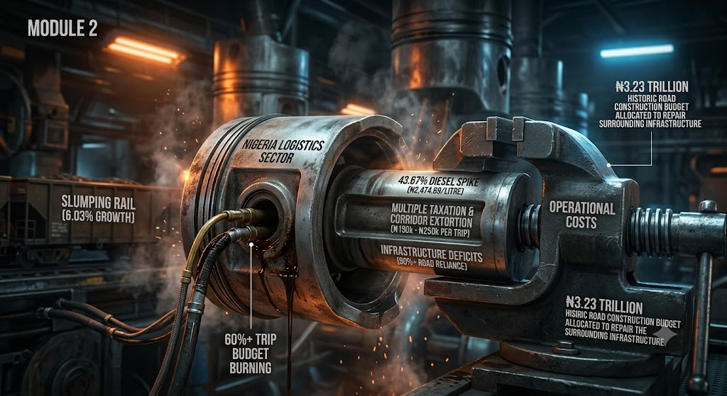

Slide 26
THE KEYNOTE HOOK — MODULE 2
When diesel prices surge past N2,400 a litre and rail freight growth stalls to just 6%, the engine room begins to choke. Goverment must know that they cannot fix inflation in downtown Lagos or Abuja if they do not fix the structural bleeding along our interstate highways. The government's N3.23 trillion road infrastructure budget is a vital step — but tarmac alone won't save us if our trucks are still stopped at over twenty illegal checkpoints every one hundred kilometers.
Dr. Boboye Oyeyemi, Keynote Address — City Business News Anniversary Lecture
MODULE 2 · SQUEEZING THE PISTONS
23

Slide 27
MODULE 03 / 04
Innovations Refueling the System
From diagnostic to forward-looking: the ecosystem is actively defending its margins through structural innovation.
INNOVATIONS REFUELING THE SYSTEM
24

Slide 28
MODULE 3 · THE CNG TRANSITION
Pivoting to Nigeria's Gas Reserves
100,000+
Vehicles converted nationwide under the Presidential Initiative on CNG
75
Active refueling stations now live across 20 states
337+
Certified conversion centers supporting the rollout
Faced with a 43.67% year-on-year surge in diesel prices, the logistics sector is pivoting toward Compressed Natural Gas as a structural hedge — not a stopgap.
MODULE 3 · INNOVATIONS REFUELING THE SYSTEM
CITY BUSINESS NEWS ANNIVERSARY LECTURE
25

Slide 29
MODULE 3 · THE CNG TRANSITION
Margin Relief — With a New Squeeze Forming
40–55%
The Headwind
Mordor Intelligence analysts note that the high upfront capital required for heavy-duty truck conversions is triggering a large-fleet CNG disruption — squeezing out smaller logistics SMEs that cannot afford the transition.
Reduction in fuel overheads for fleet operators switching from diesel to Auto-CNG — immediate, measurable microeconomic relief.
MODULE 3 · INNOVATIONS REFUELING THE SYSTEM
CITY BUSINESS NEWS ANNIVERSARY LECTURE
26

Slide 30

MODULE 3 · DIGITAL FREIGHT-MATCHING
Solving for the 20–25% Lost to Empty Miles
An estimated 20% to 25% of operational revenue is lost to “empty miles” — trucks returning empty after a delivery instead of carrying a backhaul.
To combat this, the industry is turning to Transport Management Systems (TMS) and algorithmic freight matching.
AI-driven routing and real-time shipment dashboards are now integrated across major economic corridors: Lagos, Abuja, and Kano.
MODULE 3 · INNOVATIONS REFUELING THE SYSTEM
CITY BUSINESS NEWS ANNIVERSARY LECTURE
27

Slide 31
MODULE 3 · DIGITAL FREIGHT-MATCHING
The Platforms Driving the Optimization Shift
Faramove
GIG Logistics
Travo.ng
These startups integrate AI-driven routing and real-time shipment dashboards across Lagos, Abuja, and Kano — Nigeria's busiest freight corridors.
Platforms utilizing AI load-matching and dynamic route optimization increase “backhaul” opportunities: a truck carrying raw materials from Lagos to a Kaduna factory now returns with agricultural produce or livestock for southern markets, instead of running empty.
The bottleneck: uneven internet connectivity along interior highways and limited digital literacy among informal, independent owner-operators still slow adoption.
MODULE 3 · INNOVATIONS REFUELING THE SYSTEM
CITY BUSINESS NEWS ANNIVERSARY LECTURE
28

Slide 32
MODULE 3 · DE-CONGESTING THE HIGHWAYS
The Maritime Barge Boom
Sea and inland waterways freight forwarding now captures 58.02% of the freight forwarding market's revenue share, growing at a 7.05% CAGR.
The proposed National Policy on Marine and Blue Economy has provided the regulatory framework enabling operators to bypass gridlocked port access roads.
Instead of relying entirely on trucks to clear the ports, operators increasingly route cargo through inland waterways before final-mile road delivery.
MODULE 3 · INNOVATIONS REFUELING THE SYSTEM
CITY BUSINESS NEWS ANNIVERSARY LECTURE
29

Slide 33

MODULE 3 · DE-CONGESTING THE HIGHWAYS
The Mega-Project Catalyst
Lekki Deep Sea Port
Onne Port Upgrades
Dangote Refinery
Newly commissioned capacity reshaping container flow into Lagos.
Capacity expansion supporting the eastern maritime corridor.
Targets up to 70% of refined product flows via maritime shipping across West Africa — not domestic roads.
MODULE 3 · INNOVATIONS REFUELING THE SYSTEM
CITY BUSINESS NEWS ANNIVERSARY LECTURE
30

Slide 34
MODULE 3 · SUMMARY
The Innovation Driver Scorecard
Innovation Driver | 2026 Empirical Status | Operational & Strategic Benefit
Auto-CNG Fleets | 100k+ conversions; 75 stations across 20 states | Slashes fuel overheads by 40–55%; protects margins against diesel spikes.
Digital Freight Tech | AI load-matching (e.g. Faramove, Travo.ng) | Reduces empty miles; cuts transit costs via optimized backhauls.
Barge & Waterway Shift | Waterways freight forwarding growing at 7.05% CAGR | Bypasses road congestion; handles bulk cargo directly from Lekki/Onne ports.
MODULE 3 · INNOVATIONS REFUELING THE SYSTEM
CITY BUSINESS NEWS ANNIVERSARY LECTURE
31

Slide 35
THE KEYNOTE HOOK — MODULE 3
The logistics sector is not waiting around to be saved by a drop in diesel prices. It should rewrite it own rules. When you see over 100,000 vehicles transitioning to domestic CNG, when AI-driven apps slash empty truck runs, and when inland water barges take thousands of containers off our crumbling highways, you are witnessing an engine room that is actively replacing its own parts. Innovation isn't a luxury anymore; it is the ultimate strategy for economic survival.
Keynote Address — City Business News Anniversary Lecture
MODULE 3 · INNOVATIONS REFUELING THE SYSTEM
32

Slide 36
MODULE 04 / 04
THE ROADMAP TO 2027 AND BEYOND
Transforming Nigeria's logistics ecosystem from an informal hustle into a highly competitive, formalized global asset class through policy co-creation and structural standards.
THE ROADMAP TO 2027
33

Slide 37

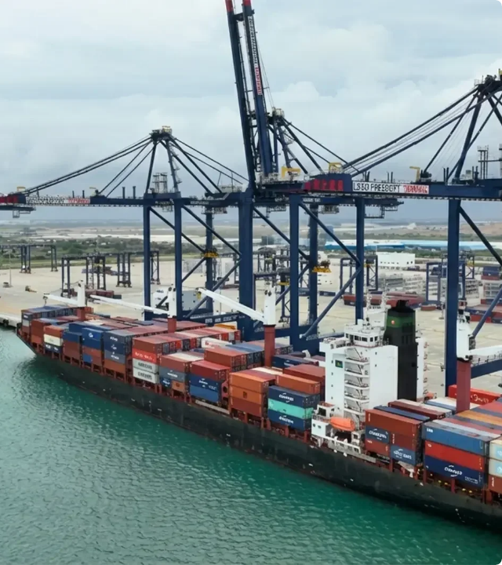
THE STRATEGIC VISION
The Unbroken Supply Chain
The mandate is to design a seamlessly integrated cargo route system that bridges transit points without frictional resistance.
Under this vision, container cargo shifts instantly from deep-sea port terminals onto standard-gauge rail wagons, transitioning smoothly to CNG-powered highway haulage vectors, delivering straight to regional consumer markets without administrative bottlenecks.

Slide 38

THE LEGISLATIVE MANDATE
The NLTP Policy Anchor
Enforced Quality Standards
The Federal Executive Council's approval of the historic National Land Transport Policy (NLTP) establishes the foundational governance infrastructure needed to formalize Nigeria's transport networks.
The core objective of the new framework is the total elimination of informal industry quackery. We are implementing legally backed, mandatory professional certifications for all regional operators.
It explicitly prioritizes systemic smart mobility integration, aggressive alternative fuels deployment, and high operational safety standards nationwide.
By leveraging the capacity-building curriculum of the NITT, we secure structural compliance, raise public trust, and incentivize high-value foreign capital investment.

Slide 39







ACTIVE POLICY FRAMEWORKS
End-of-Life Vehicle Policy Rollout
National Single Window
Regional Rail Links
Overhauled by the NADDC and fleet stakeholders to mandate rigorous technical inspections on import fleets and systematically recycle end-of-life haulage assets.
Collaboratively developed by Nigeria Customs Service and terminal authorities to digitally harmonize shipping documentation, radically compressing container port dwell times.
Direct alignment of critical, standard-gauge rail lines (Lagos-Kano corridor) with major regional industrial manufacturing centers and mega-refinery supply nodes.

Slide 40

GOVERNANCE ROADMAPS
Strategic Pillar | Policy & Legislative Mechanism | Targeted Economic Outcome
Professional Standards | National Land Transport Policy (NLTP) execution & NITT/CILT capacity building. | Eliminates market quackery; standardizes transit safety; accelerates corporate investment.
Regulatory Co-Creation | Joint implementation of the ELV Policy and National Single Window frameworks. | Streamlines complex customs clearance; formalizes the secondary transport asset pipeline.
Intermodal Governance | Public-private operational alignment across Ports, Rail, and Fleet corridors. | Achieves an unbroken supply chain; protects logistics margins from individual modal failures.

Slide 41

PROVING POLICY IMPACT
Initial Reform Victories
19.5%
Early data highlights that structured policy reforms are already driving massive results. The alignment of port operations and custom systems drove a remarkable 19.5% increase in gross registered tonnage in Q1 2026.
PORT TONNAGE INCREASE
By expanding standard-gauge rail connections and reducing regulatory bottlenecks, Nigeria is well-positioned to scale this growth toward the 2027 targets.

Slide 42
MODULE 4 · THE LEGISLATIVE MANDATE
Weeding Out Quackery
N3.2 trillion
Estimated annual cost of supply chain inefficiencies to Nigeria
42%+ of GDP
Share consumed by overall logistics costs — vastly underperforming global benchmarks
Much of this friction stems from an uncertified workforce handling multi-billion naira asset nodes
Source: Global Transport Policy roundtable data.
MODULE 4 · THE ROADMAP TO 2027
CITY BUSINESS NEWS ANNIVERSARY LECTURE
35

Slide 43

MODULE 4 · INSTITUTIONAL PILLARS
Predictive Transport Safety
Human capital development under a chartered framework will focus heavily on curbing operational hazards across the haulage fleet.
Institutionalizing professional safety certifications pushes the sector toward automated weighbridge compliance — preventing overloaded trucks from destroying road investments.
This directly protects the federal government's historic N3.23 trillion road infrastructure budget from premature degradation.
MODULE 4 · THE ROADMAP TO 2027
CITY BUSINESS NEWS ANNIVERSARY LECTURE
38

Slide 44
THE KEYNOTE HOOK — MODULE 4
“An engine room cannot function without a clear blueprint and trained Professionals. True sustainability requires public-private co-creation... That is how to power Nigeria's economic future."
Keynote Address — City Business News Anniversary Lecture
MODULE 4 · THE ROADMAP TO 2027
41

Slide 45

CLOSING
An Honest Conclusion
An overheated engine, running on grit — and the three-pronged strategy to bring it back into balance.
AN HONEST CONCLUSION
42

Slide 46
THE HONEST CONCLUSION
An Overheated Engine Running on Grit
Nigeria's logistics ecosystem is undeniably the engine room of the economy — but it is currently operating under severe, unsustainable friction. We are forcing a 21st-century economic load onto an informal, fragmented framework.
42%
Of a product's final retail cost swallowed by supply chain inefficiencies
43.67%
Year-on-year surge in diesel prices straining every haulage budget
$3b
Worth of food rotting in transit annually
Private-sector innovation — AI load-matching, CNG conversions, maritime barge tracking — creates vital buffers, but cannot substitute for structural, institutional reform.
CLOSING · HONEST CONCLUSION
CITY BUSINESS NEWS ANNIVERSARY LECTURE
43

Slide 47

RECOMMENDATION 1 OF 2
Institutionalize Public-Private Co-Creation
Harmonize the fiscal corridor: the Joint Tax Board, should enforce a single, digitally trackable interstate transit levy — eliminating the N150,000–N250,000 checkpoint extortion tax per trip.
Enforce strategic intermodal alignment: align the N3.23 trillion road and rail expansion directly with private-sector cargo evacuation points — Lekki, Onne, and major manufacturing hubs — to maximize asset utilization.
CLOSING · RECOMMENDATIONS
CITY BUSINESS NEWS ANNIVERSARY LECTURE
45

Slide 48
RECOMMENDATION 2 OF 2
Subsidize & Democratize the Green Energy Transition
Targeted credit lines: the Federal Government, via the Bank of Industry, should partner with CILT to establish asset-financing facilities dedicated to helping SME haulage operators convert to Auto-CNG.
The prize: positioning Nigeria as the dominant logistics nerve center of West Africa under AfCFTA.
CLOSING · RECOMMENDATIONS
CITY BUSINESS NEWS ANNIVERSARY LECTURE
46

Slide 49

BEFORE WE CLOSE
What This Means for You
Manufacturers & FMCG
Investors & Financiers
Policymakers & Regulators
Operators & SMEs
Audit your last-mile cold chain exposure — the 40% post-harvest loss curve is a margin opportunity hiding in plain sight.
Logistics-tech and CNG conversion financing are among the most underweighted infrastructure plays in Nigeria today.
To successfully transition Nigeria’s logistics sector from an informal, fragmented network into a formalized, globally competitive asset class, policymakers must move beyond high-level strategy and establish concrete enforcement mechanisms.
Early adopters of CNG and digital freight-matching are already capturing 25–55% in real cost advantages.
CLOSING · WHAT THIS MEANS FOR YOU
CITY BUSINESS NEWS ANNIVERSARY LECTURE
47

Slide 50

A NOTE ON THE NUMBERS
Sources & Methodology
Every figure is drawn from primary national data and recognized sector research — not estimation.
National Bureau of Statistics (NBS) — GDP, sectoral growth, and fuel price index data.
Mordor Intelligence — Nigeria freight & logistics market sizing and forecasts.
Presidential Fiscal Policy & Tax Reform Committee / Joint Tax Board — multiple-taxation and harmonization data.
Federal Ministry of Marine & Blue Economy — maritime and inland waterway policy.
Operator case studies — Faramove, GIG Logistics, Travo.ng, Dangote Refinery, Lekki Deep Sea Port.
CLOSING · SOURCES & METHODOLOGY
CITY BUSINESS NEWS ANNIVERSARY LECTURE
48

Slide 51
Nigeria does not have a production problem; it has a velocity problem. We have the market, we have the tech, and we have the geographical advantage. Let us stop managing the chaos and start regulating the future.
Thank You
City Business News Anniversary Lecture • 2026
THANK YOU
49

