Slide 1
CILT Webinar Presentation
Pipeline Transportation
& Security in Nigeria
A Global Comparison
Chartered Institute of Logistics & Transport (CILT) | Niger-Delta Pipeline Operations
TRANSPORT · SECURITY · INFRASTRUCTURE · MAINTENANCE · INNOVATION

Slide 2
Presentation Agenda
01
04
Nigeria's Pipeline Landscape
International Security Models
Overview, extent & strategic importance
Best practices from around the world
02
05
Global Pipeline Systems Compared
Role of Logistics & Transport (CILT)
USA, Russia, Canada, Saudi Arabia, Nigeria
Standards, frameworks & professional practice
03
06
Security Threats & Challenges
Recommendations & Way Forward
Vandalism, oil theft, sabotage in the Niger-Delta
Actionable strategies for Nigeria

Slide 3
01 | Nigeria's Pipeline Landscape
~5,120
2.0M+
9
70%
Km of Pipelines
Barrels/day
Major Terminals
Revenue from Oil
NNPC network
Crude capacity
Across Niger-Delta
Federal earnings
Infrastructure Overview
Strategic Significance
Nigeria holds Africa's largest proven oil reserves (37 billion barrels)
The Trans Niger Pipeline (TNP) and Bonny Export Terminal are critical national arteries
NNPC operates ~5,120 km of pipelines for crude oil, refined products & gas
The Niger-Delta region is the epicenter — home to Bayelsa, Rivers & Delta States
Key pipelines: Escravos-Lagos, Warri-Kaduna, Port Harcourt-Aba systems
Gas pipelines support NLNG and domestic power generation
Offshore pipelines connect deepwater fields to onshore terminals

Slide 4
02 | Global Pipeline Systems Compared
Country | Focus | Key Strength | Lesson for NG
🇺🇸 USA | Refined products | SCADA & real-time monitoring | Tech investment
🇷🇺 Russia | Gas export (Gazprom) | State-managed security | Centralised control
🇨🇦 Canada | Oil sands crude | Environmental compliance | Regulatory rigor
🇸🇦 Saudi Arabia | Crude export | Integrated Aramco model | Vertically integrated ops
🇳🇬 Nigeria | Crude & gas | Vast reserves | Security & maintenance gap
💡 Key Insight: Nigeria's pipeline network is comparatively small yet carries enormous national economic weight. Bridging the technology and security gap is critical to matching global standards — a core agenda for CILT members in logistics and transport.

Slide 5
03 | Security Threats & Challenges in Nigeria
Pipeline Vandalism
Illegal Bunkering
Sabotage & Militancy
Over 5,000 reported incidents annually. Illegal bunkering and crude oil theft cost Nigeria $3–$15 billion/year in lost revenue.
Organised criminal networks tap pipelines to siphon crude, with boats transporting stolen oil to illicit refineries.
Armed groups have used explosive devices on pipelines, particularly Forcados, Bonny, and Trans Forcados pipeline systems.
5,000+
Incidents/yr
$15B
Lost/year
40%
Downtime risk
Infrastructure Decay
Community Conflict
Data & Monitoring Gaps
Aging pipelines (some over 50 years old) with inadequate maintenance budgets lead to corrosion, leaks and ruptures.
Host community grievances over environmental degradation and lack of development fuel pipeline attacks in the Niger-Delta.
Limited deployment of SCADA systems and real-time leak detection compared to international counterparts.
50+
Years old (avg)
Niger-Delta
Epicenter
<30%
Monitored

Slide 6
04 | International Security Models — Best Practices
🇺🇸 United States
🇸🇦 Saudi Arabia
TSA Pipeline Security Division
Saudi Aramco Security Model
Mandatory SCADA cybersecurity standards
Real-time leak detection (Smart Pig technology)
No-fly zones over critical pipelines
Emergency response drills (annual)
Integrated military-corporate security
AI-based surveillance across 17,000 km
Community benefit programs near pipelines
Redundant pipeline routes for continuity
🇨🇦 Canada
🇷🇺 Russia
CER (Canada Energy Regulator)
Transneft Security Framework
Legislated Indigenous community engagement
Mandatory environmental monitoring
Drone surveillance & aerial inspection
Publicly disclosed incident reporting
State-funded military pipeline guard units
Centralized control rooms (24/7 ops)
Strict access control zones
Rapid-response pipeline repair brigades

Slide 7
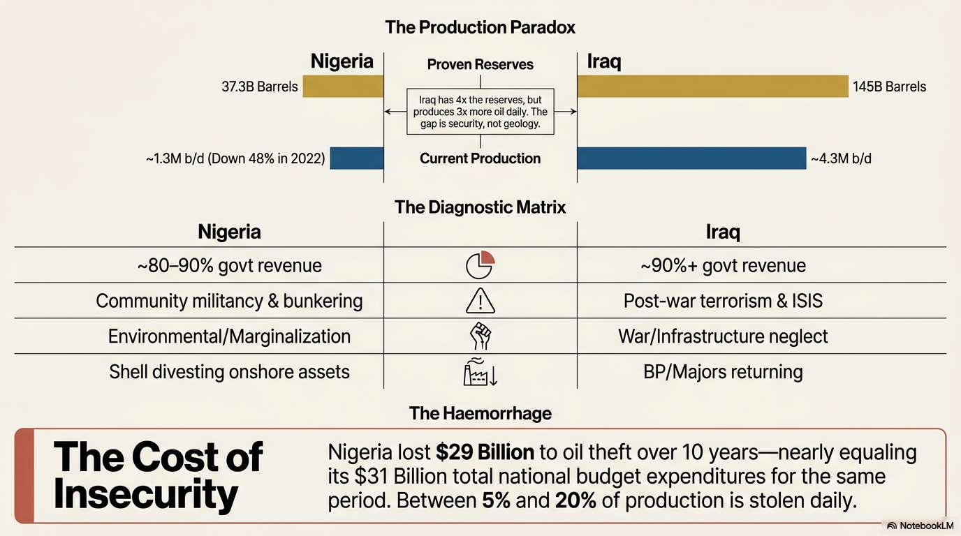

Slide 8
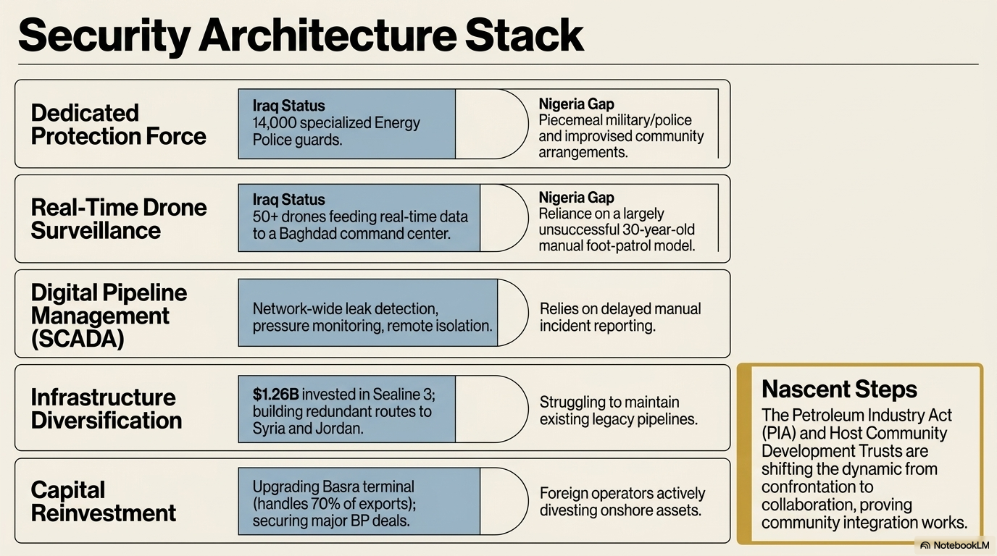

Slide 9
05 | The Role of CILT & Logistics Professionals
Pipeline transport is a logistics challenge as much as an engineering one.
Supply Chain Integration
Capacity Building
Risk & Security Standards
CILT members ensure pipeline output connects seamlessly with storage, refining, and distribution — reducing dwell time and transit losses.
CILT certifications (CMILT, FCILT) build the professional competence of pipeline operations personnel in logistics standards and ethics.
CILT frameworks support risk assessment, business continuity planning, and security protocol development for pipeline corridors.
Policy Advocacy
Innovation & Technology
Environmental Responsibility
CILT engages regulators (DPR, NUPRC, Ministry of Petroleum) to align pipeline policy with international transport standards.
Promoting adoption of IoT sensors, SCADA, GIS mapping and smart leak detection across the Nigerian pipeline system.
CILT champions sustainable logistics, ensuring pipeline operations minimize ecological damage — critical in the Niger-Delta.

Slide 10
Field Reality | Pipeline Operations in the Niger-Delta
CONSTRUCTION
⚠ CHALLENGE
✔ SOLUTION
Difficult swamp terrain, community resistance, right-of-way disputes
Trenchless technology, community engagement MOUs, modular prefab pipe
SECURITY
⚠ CHALLENGE
✔ SOLUTION
Vandalism, militant attacks, illegal connections, surveillance gaps
Armed patrol, CCTV, drone surveillance, leak detection sensors
MAINTENANCE
⚠ CHALLENGE
✔ SOLUTION
Aging infrastructure, corrosion, limited skilled workforce, budget cuts
Pigging operations, cathodic protection, CILT-certified technicians
LOGISTICS
⚠ CHALLENGE
✔ SOLUTION
Coordination of crude evacuation, product scheduling, port interface
SCADA integration, digital twinning, supply chain coordination teams

Slide 11
06 | Recommendations & Way Forward
1
Deploy Smart Monitoring Technology
SHORT-TERM
4
Professionalise Pipeline Workforce
ONGOING
Mandate SCADA systems and IoT-based leak detectors across all NNPC pipeline segments, modelled on US TSA standards.
Partner with CILT Nigeria to certify pipeline logistics personnel — from construction engineers to security coordinators.
5
Establish Rapid Response Units
SHORT-TERM
2
Legislate Pipeline Security Framework
MEDIUM-TERM
Create dedicated pipeline emergency response teams (modelled on Russia's Transneft brigades) in each geo-political zone.
Enact a dedicated Pipeline Security Act assigning roles to the military, NSCDC, and private security firms with clear accountability.
3
Community Ownership Model
MEDIUM-TERM
6
Digitise Asset Management
LONG-TERM
Adopt Canada's Indigenous engagement approach — establish formal host community investment agreements to reduce sabotage incentives.
Adopt GIS-based pipeline asset management and digital twin modelling to predict failures before they occur.

Slide 12
Thank You
Pipeline Transportation & Security in Nigeria — A Global Comparison
Nigeria's pipeline future depends on bridging the security, technology, and governance gap.
CILT professionals are uniquely positioned to drive this transformation.
Together, with global best practices and local commitment, we can build a pipeline network that truly serves Nigeria.
Chartered Institute of Logistics & Transport (CILT) | Niger-Delta Pipeline Operations
Questions & Open Discussion Welcome

