Slide 1

By
Dr. Sarah I. Daminabo
FCILT University of Port Harcourt

Slide 2
Clear Structure
Title
Africa’s Trade Paradox
Core Logistics Challenges
Border Delays
Regulatory Fragmentation
Youth as Game Changers
Digital Transformation
Role of Logistics Leaders
Practical Solutions
Trade Impact
Conclusion

Slide 3
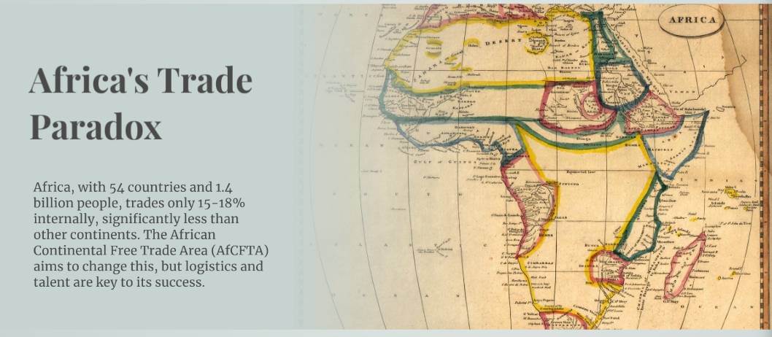

Slide 4


Slide 5
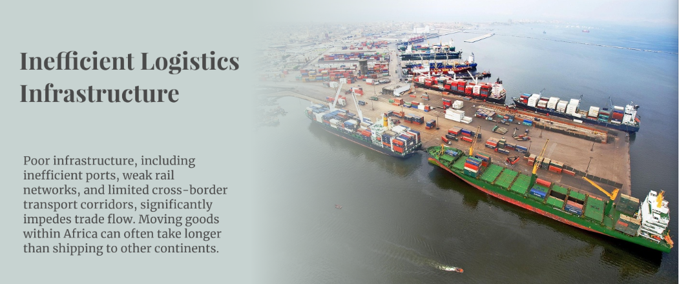

Slide 6
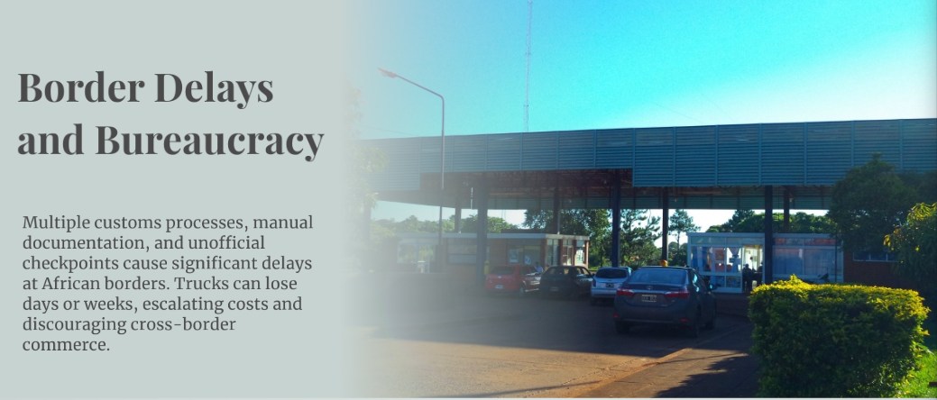

Slide 7


Slide 8
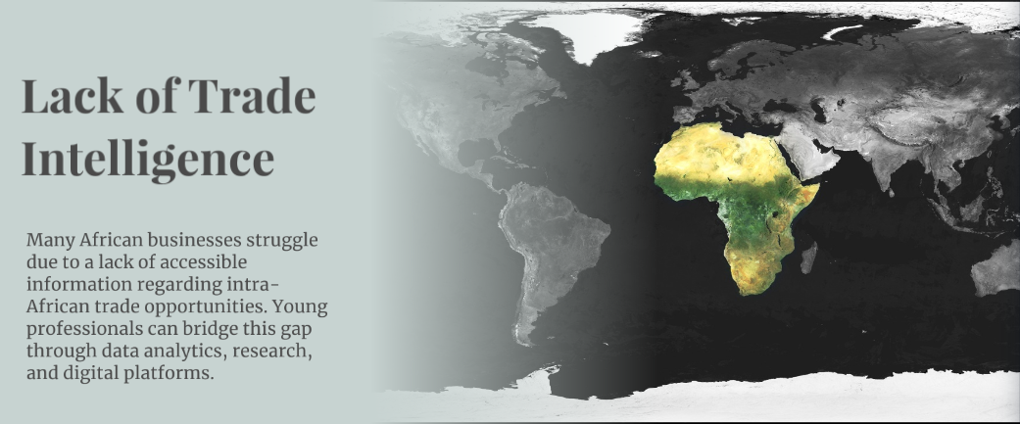

Slide 9


Slide 10


Slide 11


Slide 12


Slide 13


Slide 14


Slide 15
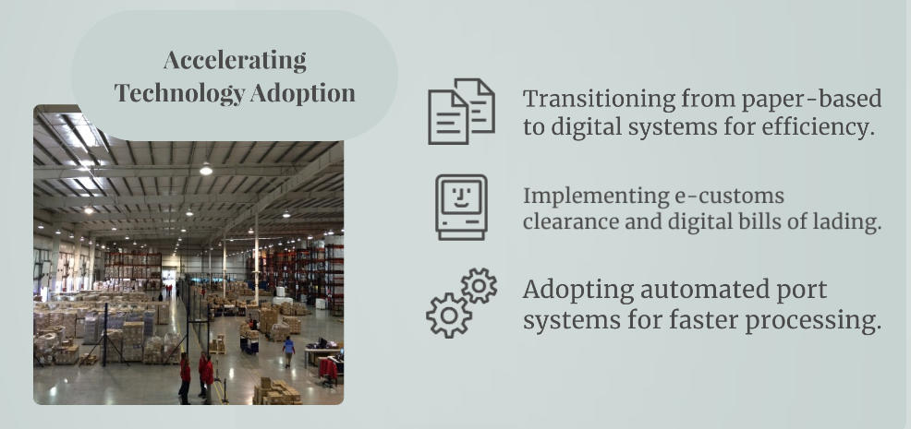

Slide 16
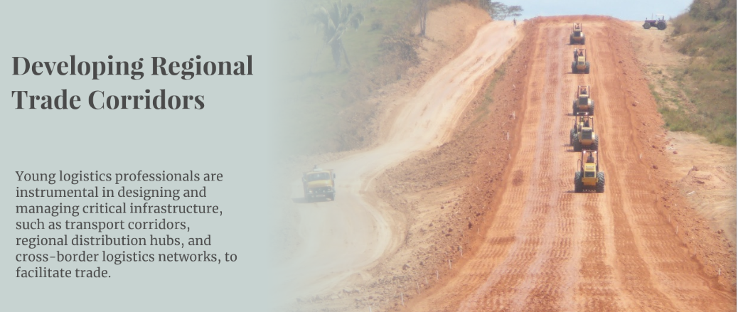

Slide 17


Slide 18


Slide 19
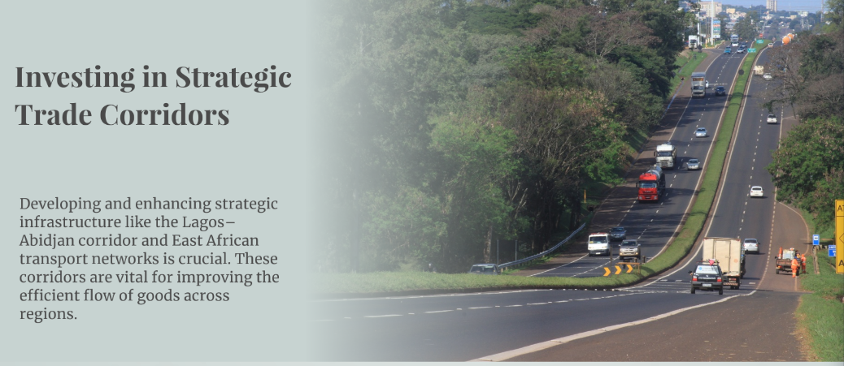

Slide 20


Slide 21


Slide 22


Slide 23


Slide 24


