Slide 1

Multimodal Transport Safety in Nigeria
Prospects, Challenges & Contribution to National Growth
PURSUANT TO THE RENEWED HOPE AGENDA
Guest Speaker Presentation | 12 Nigeria Transport Lecture
Boboye Oyeyemi, Ph.D
OFR, mni, NPOM, FCILT, FCIPM, FNIM
President and Chirman of Council
The Chartered Institute of Logistics and Transport (CILT) NIgeria

Slide 2
Presentation Roadmap
•
Multi-modal
•
Strategic Interventions: NLTP & ITS
•
Landscape: Current Multimodal Data
•
Sustainability: Green Transition & CNG
•
Safety Crisis: Diagnostics & 2025 Stats
•
Governance: NITA & Policy Discipline
•
Structural Challenges & Bottlenecks
•
FVision: The Renewed Hope Agenda
•
The Economic Multiplier Effect
•
Conclusions & Recommendations

Slide 3

SECTION 01
Undersatnding Multimodal Transport
The Nigeria Reality

Slide 4

Introduction
Integrated multi-modal transportation refers to a system that
seamlessly connects different modes of transportation, such
as roads, rail, air, and waterways, to facilitate the
efficient movement of people and goods in a single journey. It
involves the seamless and coordination, integration, and
interoperability of various transportation modes to provide a
comprehensive and interconnected transportation network;
leveraging on the strength of the different modes of
transportation.
Transportation is the lifeblood of economic development, social integration, and national competitiveness. Nigeria's transportation system comprises road, rail, air, inland waterways, pipelines, and maritime transport. The effectiveness of these modes depends not only on infrastructure availability but also on the safety, security, and seamless integration of transport operations.

Slide 5
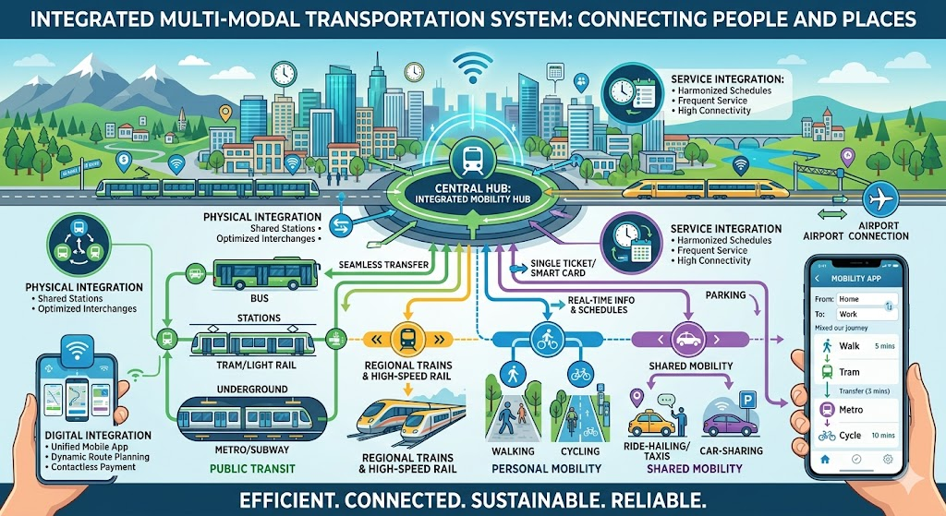

Slide 6
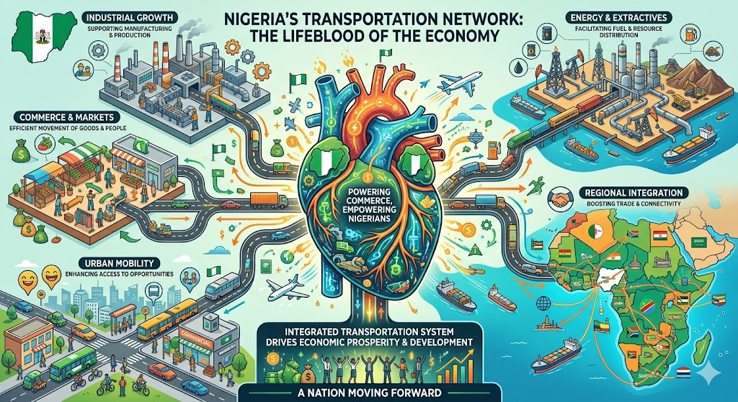
Multimodal transport safety refers to the coordinated management of safety across different modes of transportation to ensure the efficient movement of people and goods while minimizing accidents, losses, environmental damage, and operational disruptions.

Slide 7
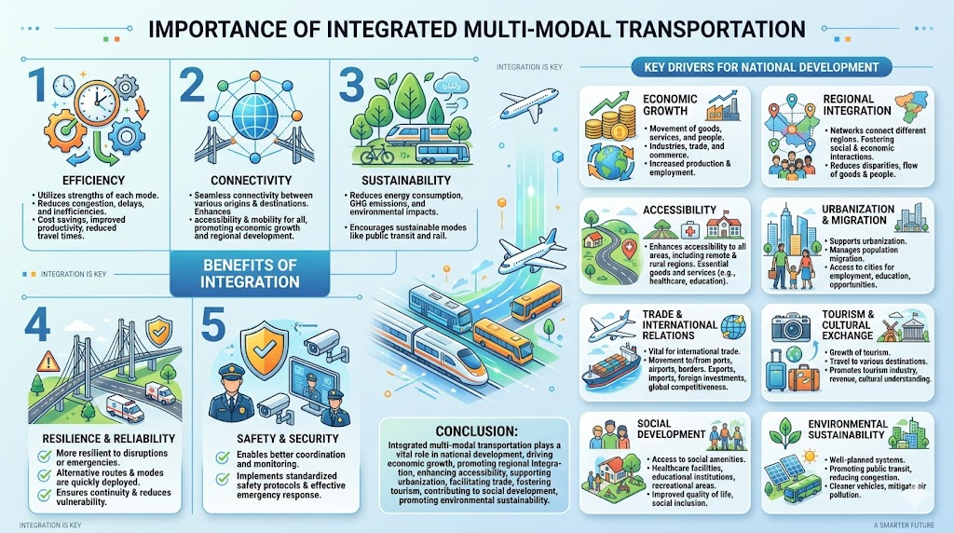
Introduction

Slide 8
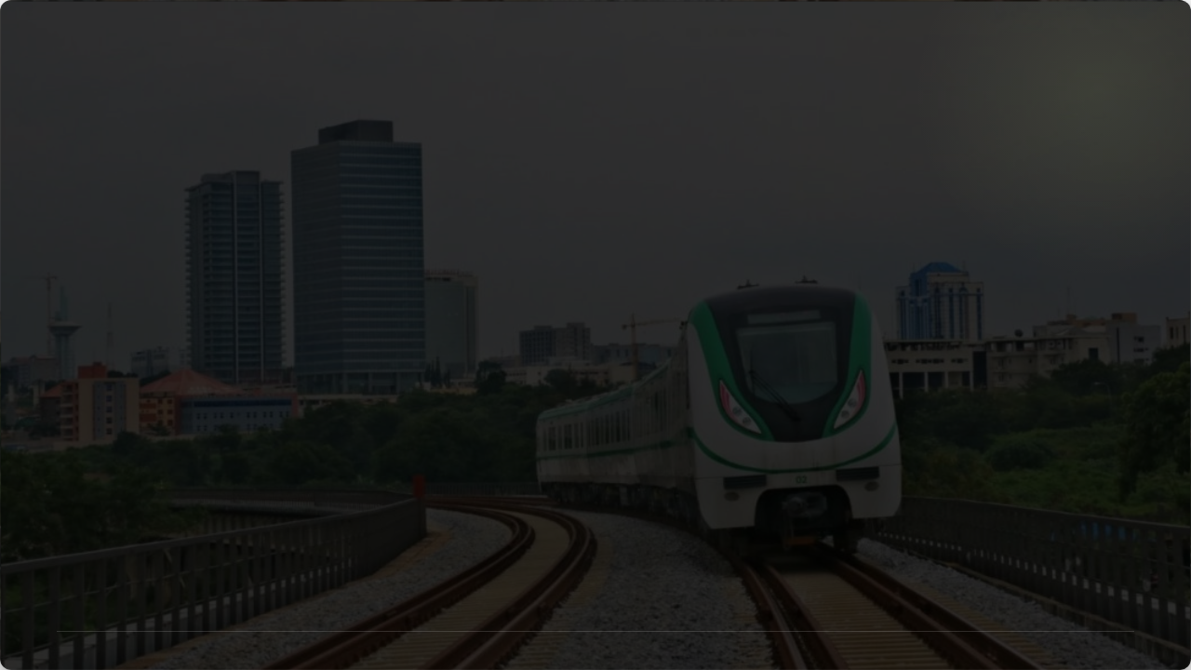
SECTION 02
State of the Landscape
Current Performance, Dependencies & Vulnerabilities

Slide 9

Road Dependency: 90% Volume
The 90% Trap
90%
Nigeria's reliance on roads is disproportionate compared to regional peers.
•
Accelerated degradation of paved road network.
•
Only 30% of roads are currently paved (Agusto Store).
•
High exposure to traffic safety risks.

Slide 10
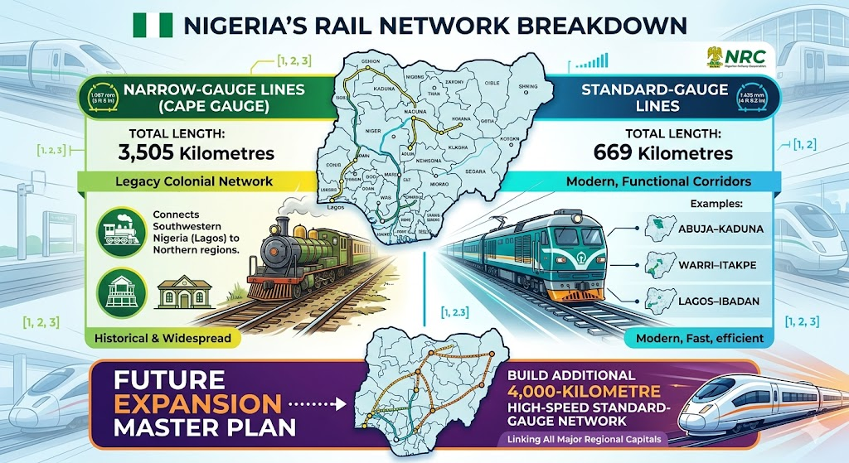

Slide 11
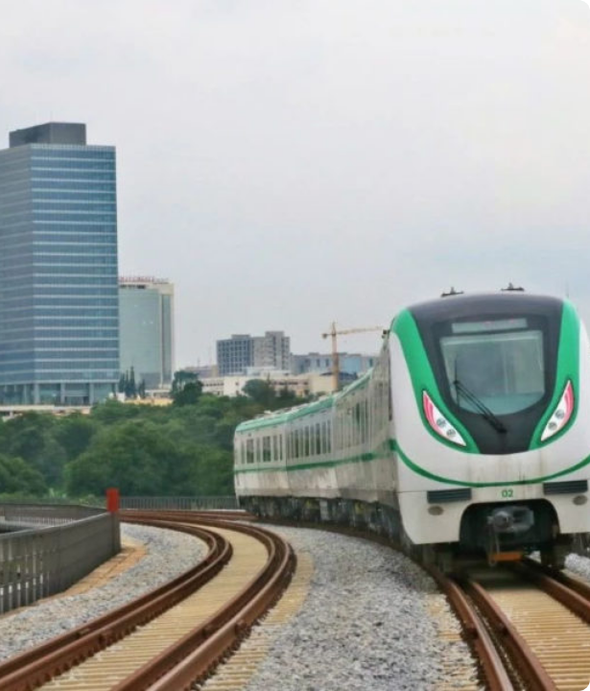
Rail: Standard Gauge Progress
The Nigerian Railway Corporation (NRC) is witnessing a revitalization through Standard Gauge (SGR) corridors.
•
Lagos-Ibadan SGR Operational.
•
Abuja-Kaduna Corridor connectivity.
•
Rehabilitation of Eastern Narrow Gauge (PH to Aba).
Source: NRC / Min. of Transportation 2025

Slide 12

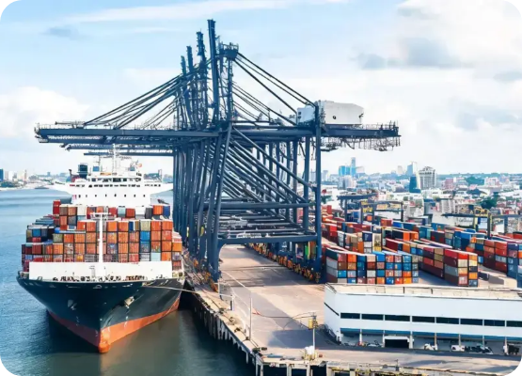
The Blue Economy Prospect
Unlocking Port Efficiency
The newly created Ministry of Marine and Blue Economy targets:
•
24-hour port operations.
•
Direct Rail-to-Port interchanges.
•
Inland Waterway commercial viability.
Zero piracy incidents in 3 years (NIMASA).

Slide 13
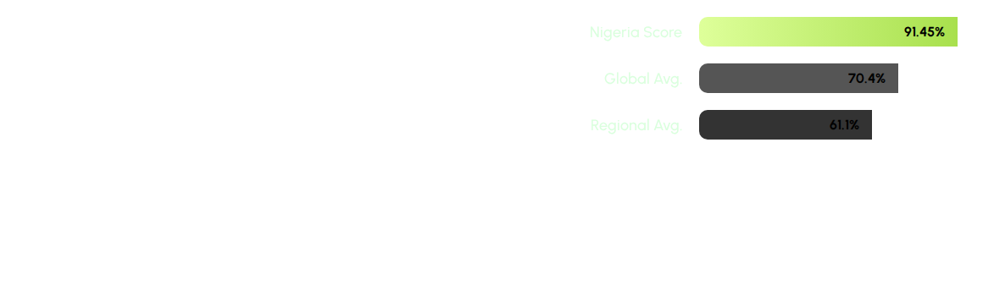

Aviation Safety Excellence
ICAO Audit Results 2026
Nigeria's aviation safety standards outperform regional and global averages.
91.45% Compliance
A benchmark for regulatory efficiency and compliance in other transport modes.

Slide 14
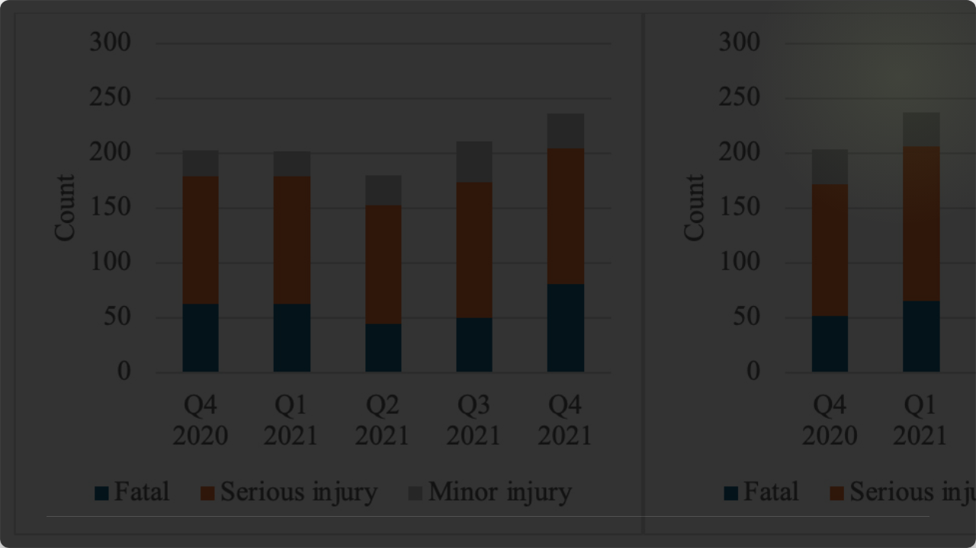
SECTION 03
The Safety Crisis
Diagnostic Analysis of Accidents & Enforcement (2025 - 2026)

Slide 15
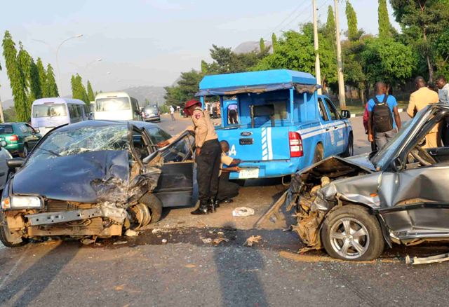

Road Traffic Crash (RTC) 2025
FRSC Data Review
2025 saw a paradoxical trend: more crashes and injuries, but fewer fatalities.
Metric | Count
Total Crashes | 10,446
Fatalities (Deaths) | 5,289
Total Injuries | 33,400
Source: Federal Road Safety Corps (FRSC) Feb 2026

Slide 16

Causality: The 41% Speed Factor
Primary Threats to Life
Speed remains the single greatest threat on Nigerian roads, accounting for nearly half of all identified causes.
41%
•
Speed limit violations (41%)
Speeding Crashes
•
Dangerous overtaking
•
Brake & tyre failure (Maintenance)

Slide 17


Enforcement: The "Big Five"
In 2026, the FRSC announced zero tolerance for the offences responsible for 70% of fatal crashes:
01. Speeding
02. Drunk/Drugged
03. Wrong-Way
The primary killer in 2025 crashes.
Rising trend in commercial driver abuse.
Major cause of mass casualty head-on collisions.
04. Dangerous Driving
05. Overloading
Status: Active
Reckless overtaking and lane violations.
Causing brake failure and road damage.
Enforcement up 28.3% in 2025.

Slide 18
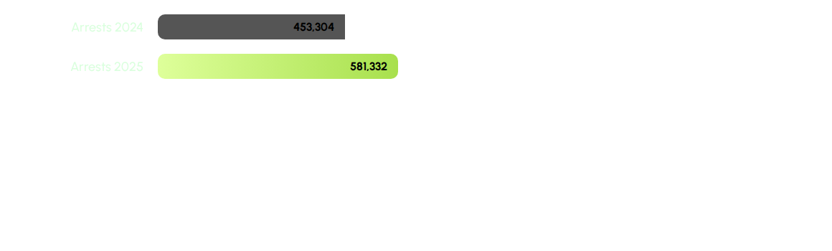

Enforcement Trends 2025
Intelligence-Led Operations
The FRSC recorded a 28.3% increase in arrests, reflecting intensified patrol and improved surveillance.
+128,028 Arrests
Aim: Deterrence through visible and firm enforcement.

Slide 19
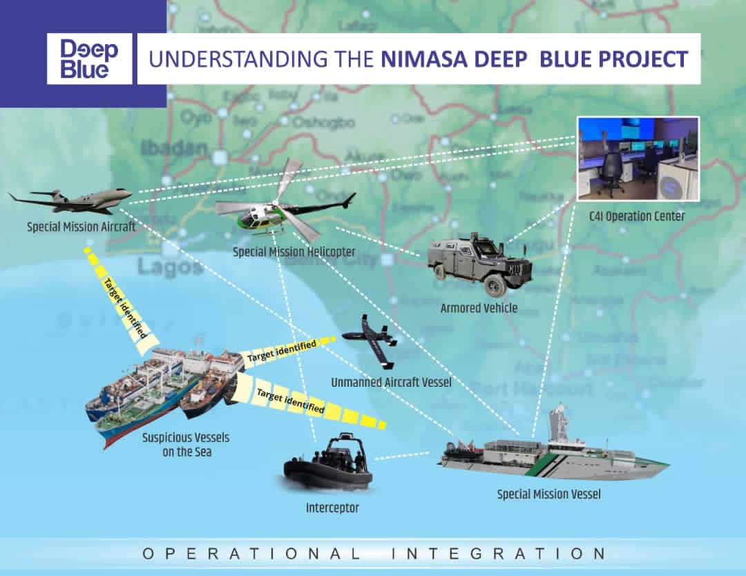
Deep Blue: Maritime Security
3 Years Zero Piracy
Sustained implementation has transformed Nigeria's maritime security architecture.
•
Integrated Air, Land, and Sea assets.
•
70% decline in piracy across Gulf of Guinea.
•
Expansion planned to Bakassi Peninsula (2026 ending).
Source: Min. of Marine & Blue Economy (May 2026)

Slide 20


The Dividend of Security
Economic Gains
Stable maritime security directly lowers trade costs.
•
Removal of "War Risk" insurance premiums.
Gulf of Guinea Leadership
•
Increased vessel turnaround frequency.
Nigeria's reforms have restored global confidence in the regional logistics corridor.
•
Return to the IMO Council (14-year absence).

Slide 21
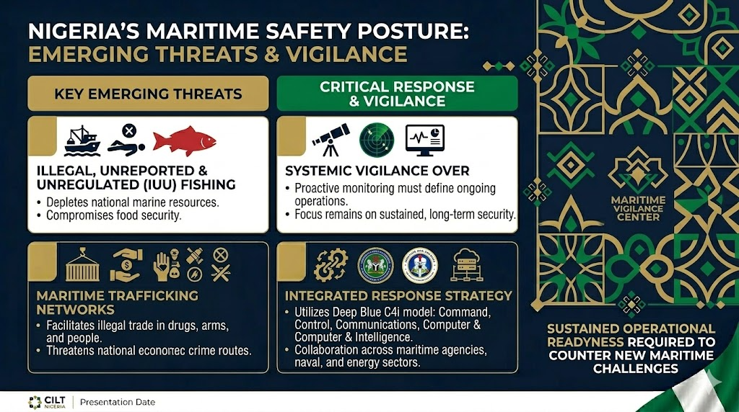
•
•
•

Slide 22
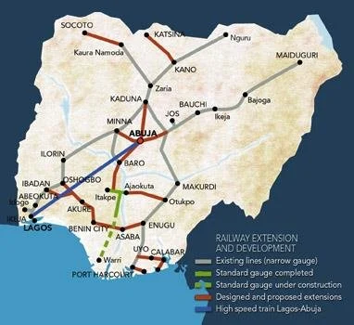
Rail Safety: Protection vs Vandalism
Asset Vulnerability
The NRC faces persistent challenges with infrastructure sabotage.
•
Theft of track clips and sleepers.
•
Vandalism of signaling equipment.
•
Threat: Loss of communication "dark territories."
Response: Railway Police and Surveillance drones.

Slide 23
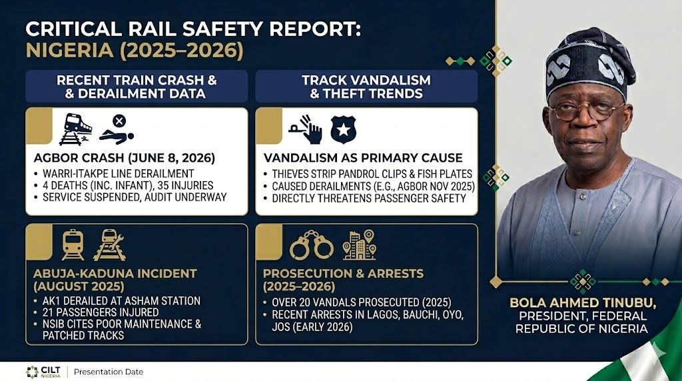
Rail Safety: Protection vs Vandalism
•

Slide 24
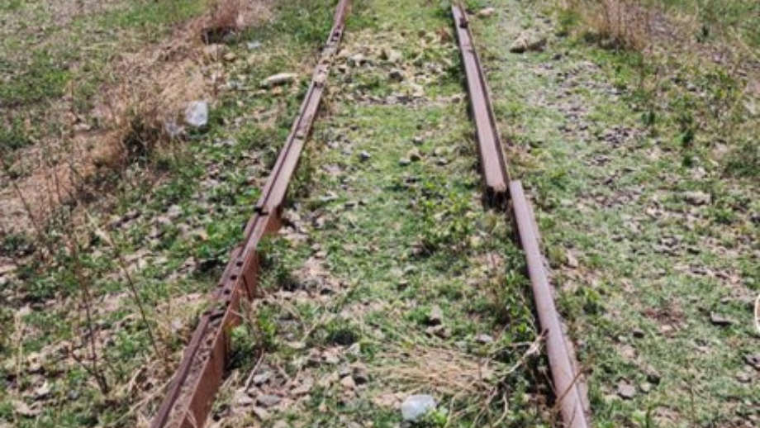
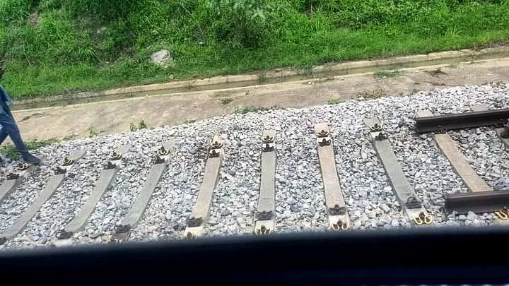
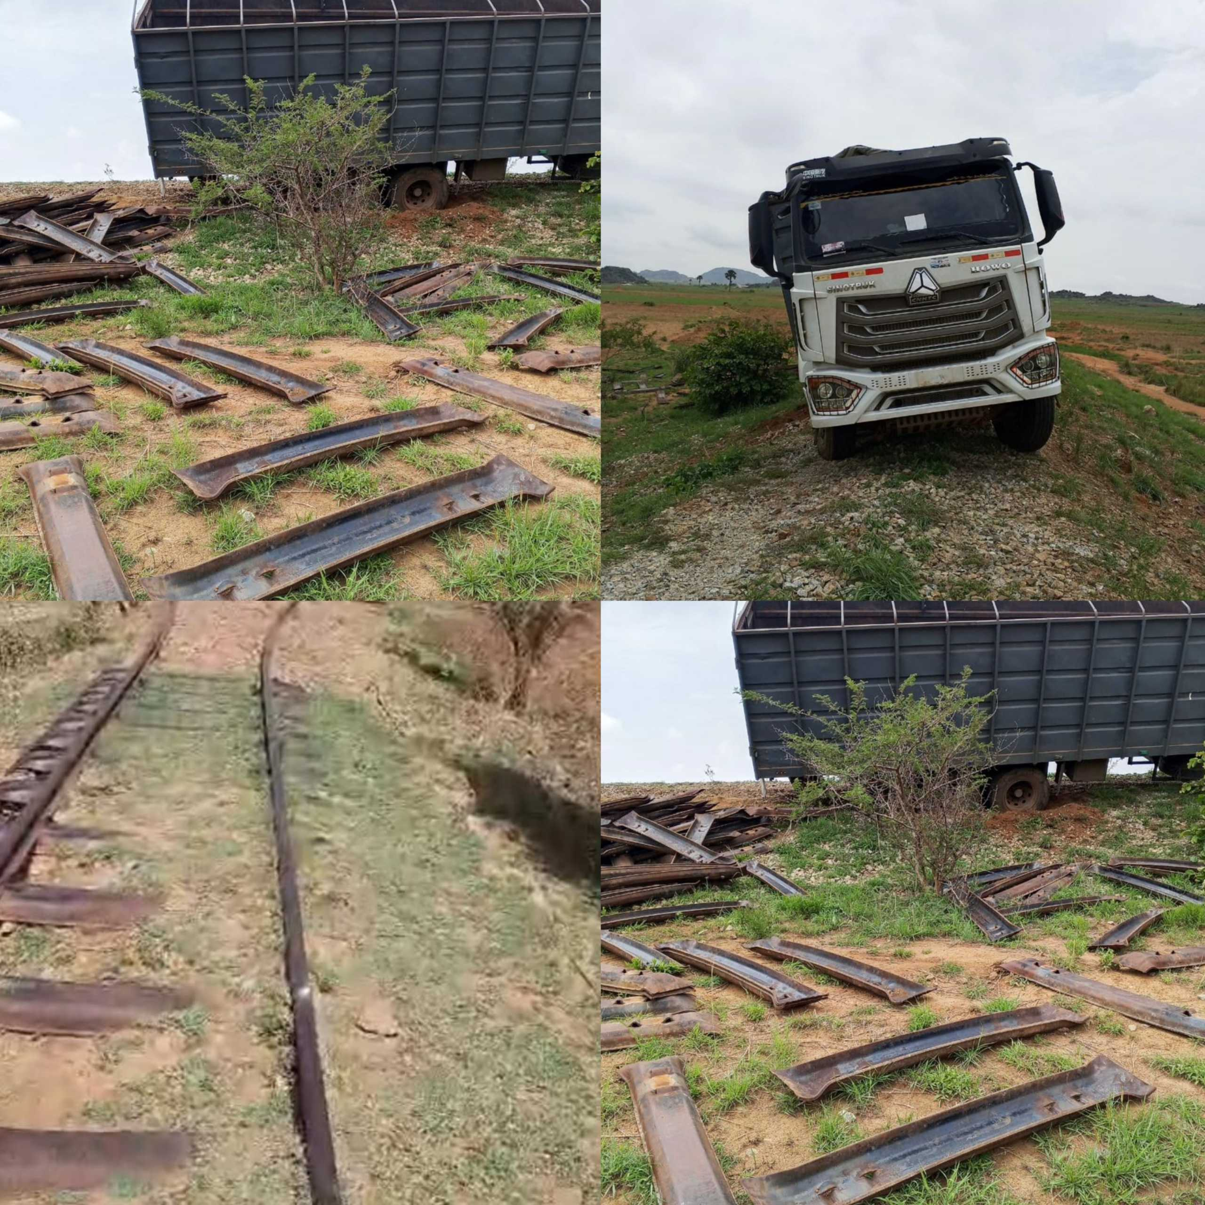
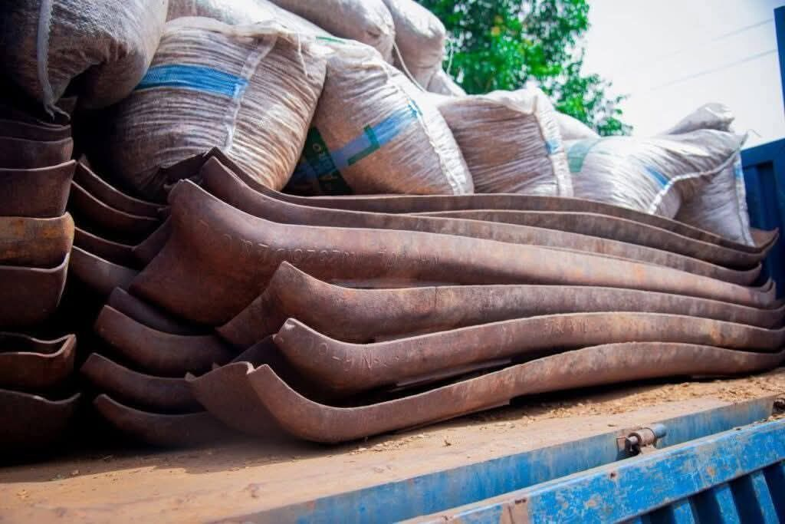
Rail Safety: Protection vs Vandalism
•

Slide 25
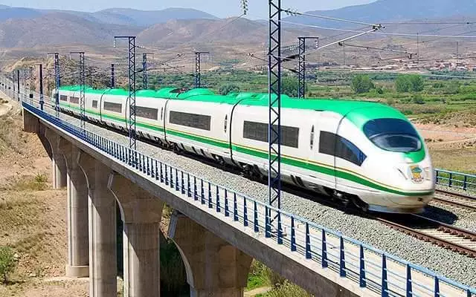
SECTION 04
Structural Challenges
Bottlenecks, Maintenance Deficit & Institutional Friction

Slide 26
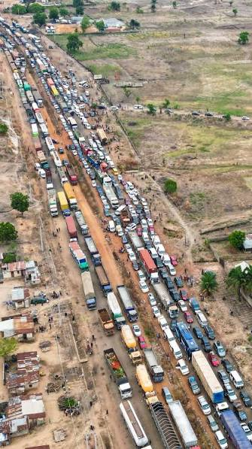
The Hidden Inefficiency Tax
Transport as a Cost Driver
Inefficiency functions like a regressive tax on every sector of the economy.
•
Increases food price inflation.
•
Raises business failure rates.
•
Reduces industrial competitiveness.

Slide 27
Port Cargo Dwell Times
Country | Avg. Dwell Time (Days) | Efficiency Gap
Rep. of Benin | 4 Days | Benchmark
Ghana | 7 Days | Moderate
Nigeria (2025) | 21 Days | Critical Delay
Goal: 7-Day Clearance via "Single Window" by end of 2026.

Slide 28
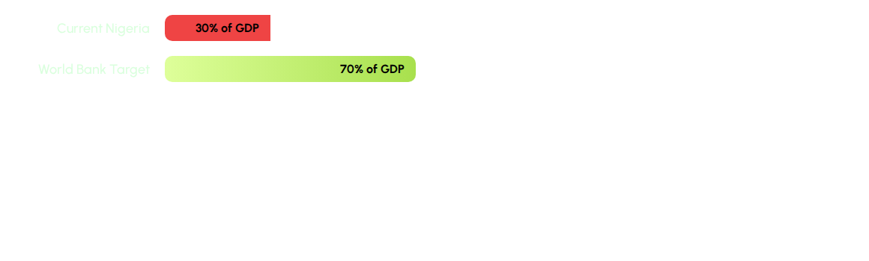

The Infrastructure Deficit
The 40% Gap
Nigeria's core infrastructure stock is significantly below international benchmarks required for sustainable growth.
Result: High pressure on existing assets and frequent system breakdowns.

Slide 29
The 40% Paved Reality
The Dust & Mud Burden
40%
Out of the estimated 204000-kilometer road network, only a fraction is designed for modern heavy haulage.
•
Vulnerability to seasonal weather (Floods).
•
High vehicle maintenance costs for operators.
Only 40% of Roads Paved
•
Constraint on rural-to-urban logistics.

Slide 30


The Energy Vulnerability
Diesel & PMS Dependency
High fuel costs directly correlate with the inflationary spike in transport fares.
Inflation Driver
•
35%+ of Opex driven by diesel costs.
Every N100 increase in fuel translates to immediate shifts in food pricing.
•
Exposure to global energy volatility.
•
Inflation impact: 15.69% headline rate.

Slide 31



Governance Fragmentation
Mandate Overlap
Silo Planning
Weak Enforcement
Multiple agencies claiming jurisdiction on same corridors.
Road planners disconnected from Rail and Port authorities.
Low adherence to safety codes due to administrative friction.

Slide 32

SECTION 05
Economic Multiplier Effect
Prospects for Growth, Trade & AfCFTA Dominance

Slide 33
Market Projection 2026
Growth Opportunity
$11.66B
The Nigeria freight and logistics market is poised for significant expansion.
•
$10.95B (2025) → $11.66B (2026).
•
Driving demand for intermodal terminals.
Projected Market Value 2026
•
Opportunities in cold-chain and e-commerce.
Source: Globenewswire / Jan 2026

Slide 34


AfCFTA: Regional Dominance
Intra-African Trade
African Continental Free Trade Area (AfCFTA) success is tied to cross-border logistics efficiency.
•
The AfCFTA Gap
Nigeria as a regional logistics hub.
•
Africa Intra-trade (22%) vs Europe (67%). Seamless multimodal connectivity is the only way to close this.
Reducing non-tariff barriers (Delays).
•
Syncing transit codes with West African neighbors.

Slide 35
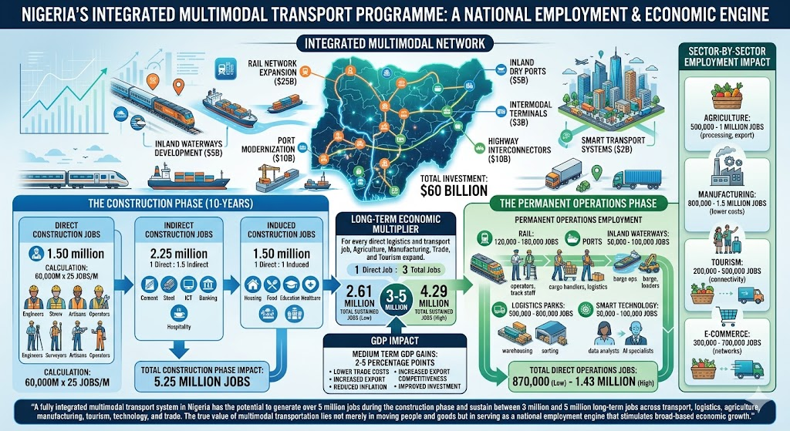
Job Creation Multiplier
The 14,000+ Impact
Investments in structured multimodal transport create massive employment pipelines.
•
14,000 jobs created via Kaduna BRT project.
•
Driver training, Maintenance, & Hub Ops.
•
Spillover growth in formalizing informal sectors.

Slide 36
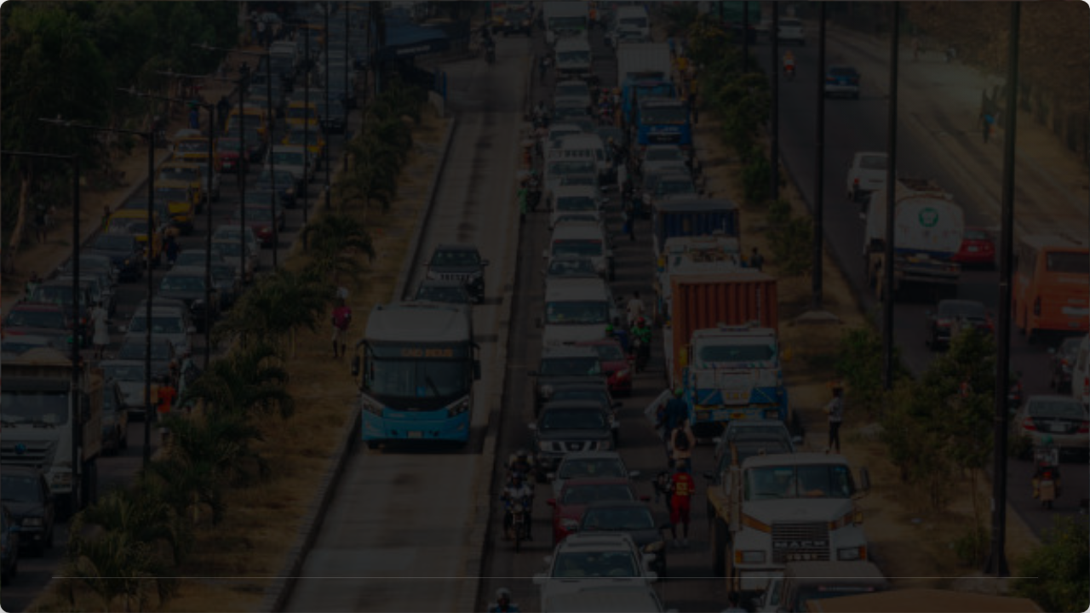
SECTION 06
Strategic Interventions
Policy Frameworks, Smart Mobility & Digital Identity

Slide 37
National Land Transport Policy
Approved in Nov 2025, the NLTP marks the first cohesive roadmap for modernizing the sector.
01. Modernize
02. Integrate
03. Digitalize
Upgrading physical assets to global benchmarks.
Ensuring seamless intermodal connectivity.
Adopting Smart Mobility and ITS solutions.
"A framework on which the sector needs to operate." — Minister Alkali.

Slide 38
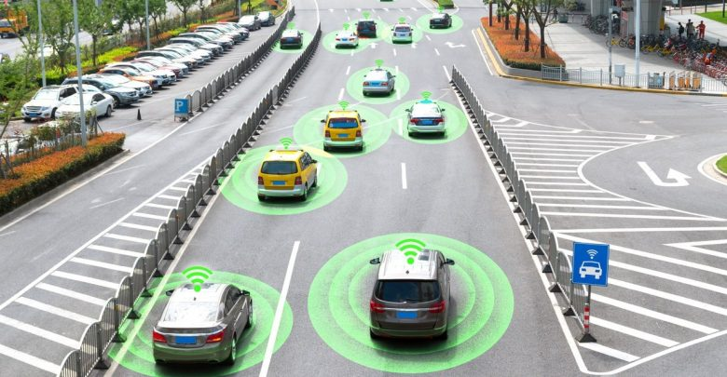
Intelligent Transport Systems (ITS)
Technology as Enforcer
ITS minimizes human error and reduces bureaucratic friction.
•
AI-enabled traffic flow monitoring.
•
Automated speed and weight sensors.
•
Digital manifest & ticketing systems.

Slide 39

Blockchain in Logistics
Eliminating Corruption
Blockchain enables a "Single Window" for customs and regulatory clearance.
Transparency
•
Reduced paper trail (lower error margin).
Immutable ledgers for cargo tracking and documentation.
•
Instant verification of insurance and safety codes.
•
Secure cross-border logistics data.

Slide 40

Measure What We Manage
"You cannot optimize a transport network without a Transport Data Intelligence hub."
Real-Time Tracking
Predictive Analytics
National Registry
Fleet and corridor velocity monitoring.
Forecasting maintenance and traffic spikes.
Unified digital transport identity for assets.

Slide 41
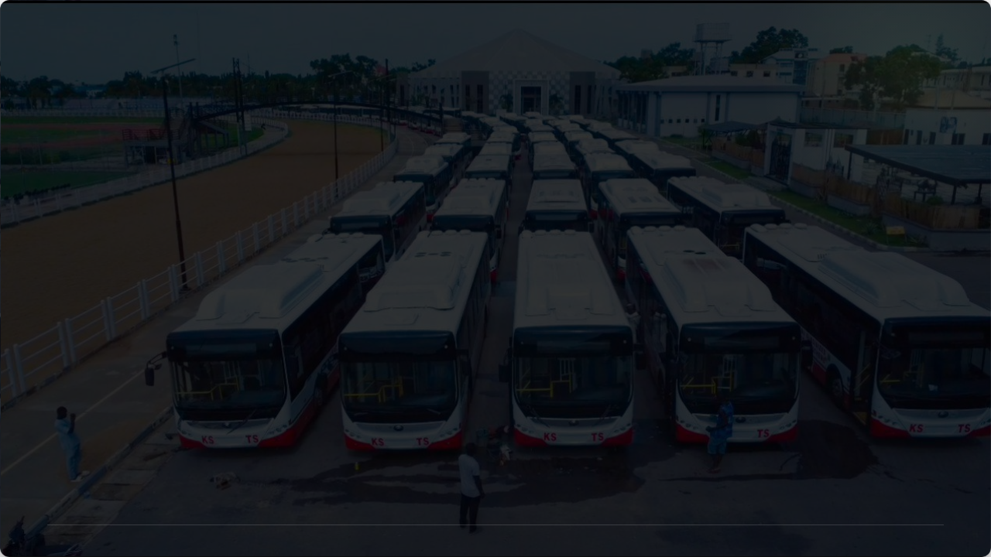
SECTION 07
Sustainability & Green Transition
Decarbonization, CNG & Climate Resilient Design

Slide 42
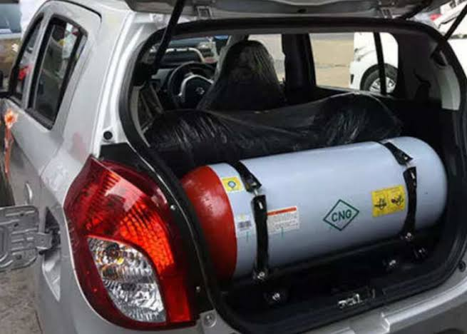
The CNG Conversion Program
Scaling Clean Energy
The Presidential Initiative on CNG is active across 23 states.
•
337+ Certified Conversion Centers.
•
75 Active Refueling Stations.
•
Target: 36 states coverage (2026).

Slide 43
The Electric Vehicle Bill 2025
Fiscal Incentives
Charging Grid
Local Content
Tax holidays and duty waivers for local EV assembly.
Mandate for chargers at all licensed fuel stations.
Target: 30% local component sourcing by 2030.
Aim: Position Nigeria as a regional green automotive hub.

Slide 44

Flood-Resistant Engineering
Surviving the Flood Cycle
Infrastructure must be designed for an environment of climate volatility.
Resilience Metric
•
Smart Drainage: Real-time flow sensors.
Road design must move from asphalt standard to rigid concrete on heavy-traffic corridors.
•
Heat-Resilient Pavement technologies.
•
Wetland Preservation as flood buffers.

Slide 45

Rigid Pavement: 40-Year Life
The Concrete Advantage
Strategic shift toward rigid concrete for heavy-freight national corridors.
40-Year Life Cycle
•
Higher resistance to water saturation.
vs 15-Year Asphalt
•
Lower long-term maintenance costs.
•
Sustains higher axle loads without delamination.

Slide 46
Non-Motorized Transit (NMT)
Walking Lanes
Cycling Grid
TOD Design
Widened, protected pedestrian systems.
Dedicated lanes integrated with mass transit hubs.
Transit-Oriented Development: Work/Live near transit hubs.

Slide 47
Decongesting the Coast
Inland Dry Ports (IDPs)
Extending maritime customs zones into the hinterland allows cargo to clear away from congested ports.
•
Kaduna, Kano, & Ibadan Dry Ports active.
•
Freight Villages: Centralized logistics staging.
•
Reduces urban truck traffic gridlock.

Slide 48
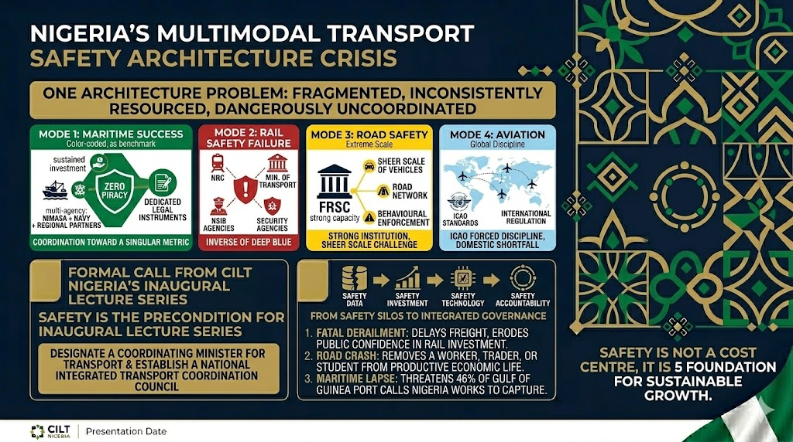
•
Nigeria does not have four separate transport safety problems. It has one multimodal transport safety architecture problem and that architecture is fragmented, inconsistently resourced, and dangerously uncoordinated

Slide 49
SECTION 08
The Renewed Hope Vision
Aligning Transportation with National Priorities (2023 - 2027)

Slide 50
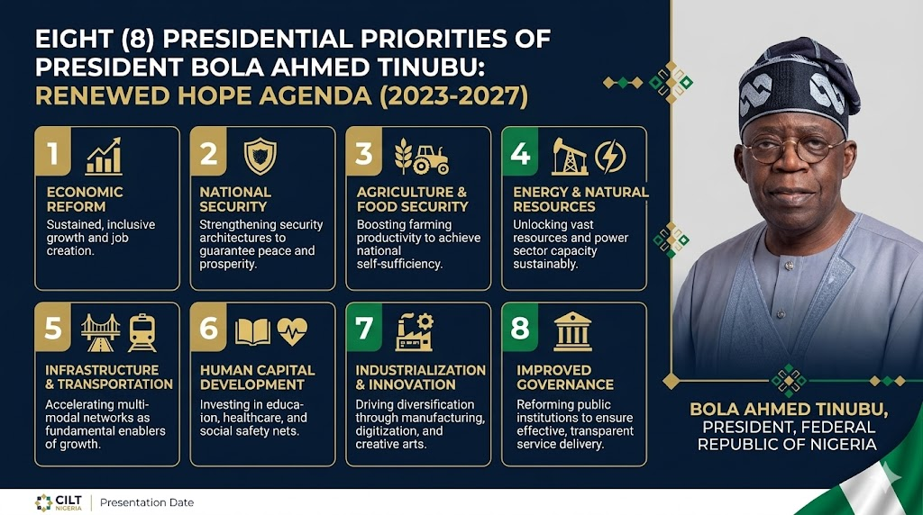
•
•
•

Slide 51

The Presidential Priorities
President Bola Ahmed Tinubu's administration has identified key sectors for Nigeria's 2023–2027 transformation.
•
Priority 2: National Security & Peace
•
Priority 5: Infrastructure & Transport
•
Priority 7: Industrialization & Innovation
Source: CRDCU / Renewed Hope Agenda Strategy

Slide 52
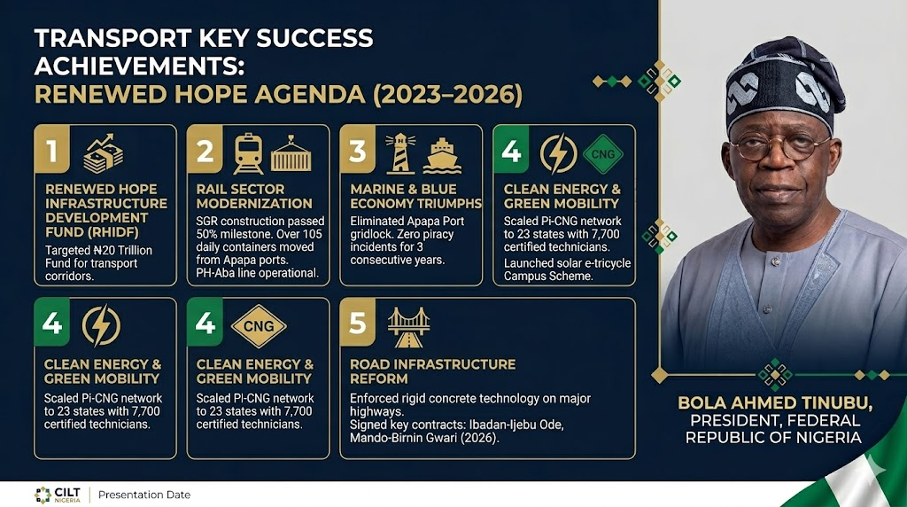
Structural Financing: The Renewed Hope Infrastructure Development Fund (RHIDF). Approved in March 2024, the RHIDF was established to address Nigeria's $878 billion infrastructure gap by targeting an annual deployment of up to $35 billion through 2040.

Slide 53
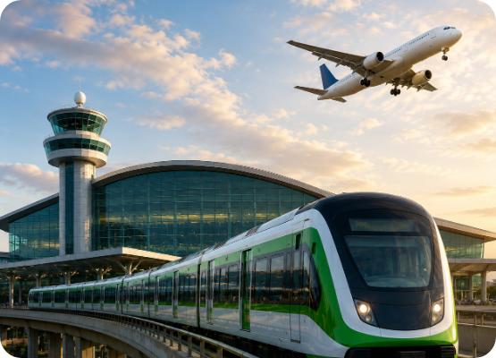

Priority 5: Enablers of Growth
Transport as a Pillar
The "Renewed Hope" Agenda recognizes that an integrated, multimodal transport network is the bedrock of industrial growth.
Efficiency × Safety = Economic Velocity
Modernizing networks increases regional competitiveness and reduces the cost of doing business.

Slide 54

"Transportation is not just a sector within the economy—it is the multiplier of national growth. When the economy expands, transport grows with it; but when transport is efficient, integrated, and intelligent, it accelerates economic growth beyond limits and transforms development into prosperity.”.
— Final Vision for Renewed Hope

Slide 55
SECTION 10
Conclusions & Recommendations
Toward a Resilient, Integrated & Secure Nigeria

Slide 56

Rec I: Policy Discipline & Continuity
Implementation Enforcement
Nigeria has enough plans; the problem is implementation discipline.
Rule of Law
•
Strict adherence to the NLTP 2025 roadmap.
Private capital follows contract enforcement and regulatory clarity.
•
Consolidation of overlapping agencies.
•
Transparent bankable project pipelines.

Slide 57
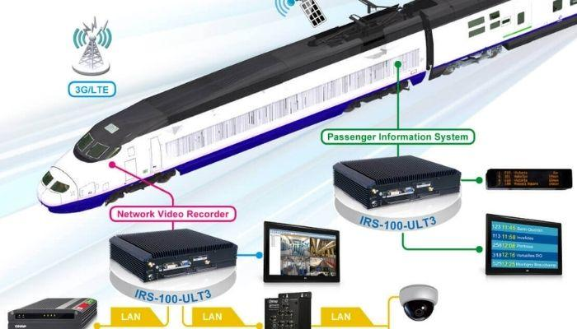
Rec II: Tech & Security Sync
Integrated Command
Transport security is national security.
•
Scale Deep Blue C4i model to terrestrial road/rail.
•
Satellite & Drone monitoring for corridors.
•
Smart ticketing & Identity links.

Slide 58
Rec III: Energy Diversification
Scale Pi-CNG
EV Charging
Renewables
Nationwide coverage of conversion and refueling.
Build the charging spine at all major fuel outlets.
Solar-powered hub operations for resiliency.

Slide 59
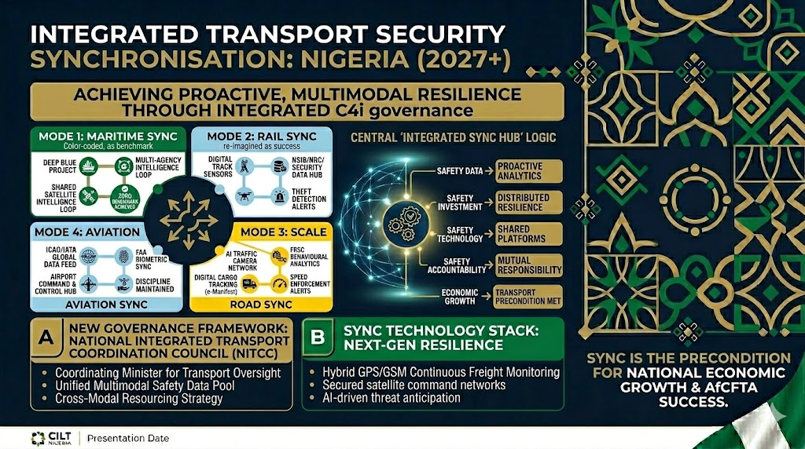

Slide 60
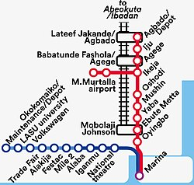
Case Study: Lagos Blue Line
3.5 Million Riders Success
The success of the Blue Line proves the appetite for safe, modern multimodal transit.
•
Reduced travel time by 60%.
•
Integrated Ticketing (Cowry Card).
•
Model for urban mass transit across the FCT and Port Harcourt.

Slide 61
Let us build the Future.
A Secure, Efficient, & Integrated Nigerian Transport Ecosystem.
www.ciltnigeria.org
THANK YOU FOR LISTENING

Slide 62
Data Sources & References
•
Federal Road Safety Corps (FRSC) Annual Stats, Feb 2026.
•
NBS Rail Transportation Data Q4 2025.
•
Renewed Hope Agenda (Priority Areas Strategy) 2023-2027.
•
National Land Transport Policy (NLTP) Approved FEC, Nov 2025.
•
Min. of Marine and Blue Economy Deep Blue Expansion Report, May 2026.
•
LAMATA ITS & AI Traffic Infraction Report, May 2026.
•
CILT Nigeria Professional Standards Framework 2026.
•
Agusto Store Infrastructure Industry Report 2024/2025.
•
Zipline Medical Network Expansion Impact, Startup Researcher May 2026.
•
Globenewswire Freight & Logistics Market Analysis Jan 2026.

